Slide 1
Network expansion of genetic associations defines a pleiotropy map of human cell biology
Barrio-Hernandez et al.
Presenter: Wanjun Gu, Baranzini Lab
QBC Journal Club
Oct 1st, 2024

Slide 2
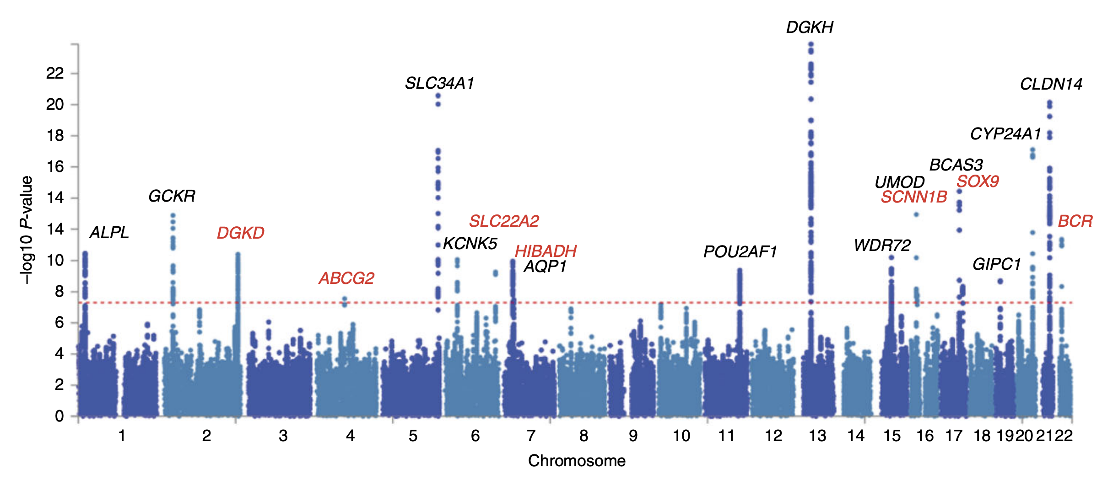
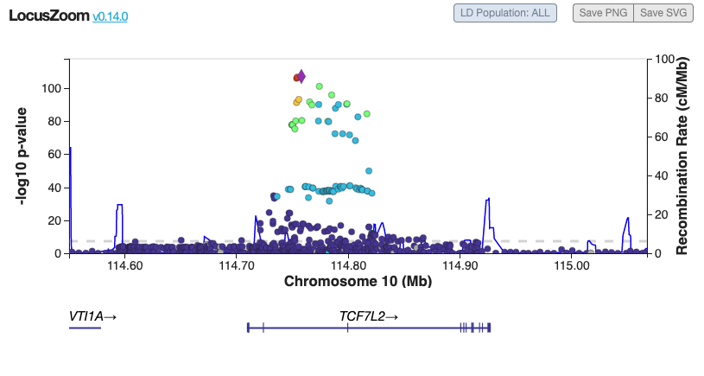
Background and motivation
Gnome-wide association studies (GWAS)
GWAS compares the genomes of many people to identify genetic markers associated with a disease or trait
Notes:
Simple Explanation: The figure shows how many connections (edges) and elements (nodes) are in different parts of the interactome, which is a network of protein interactions. The largest component is from the STRING database, followed by the OTAR dataset. Smaller contributions come from IntAct, Reactome, and SIGNOR, showing how these sources combine to form a comprehensive network.

Slide 3
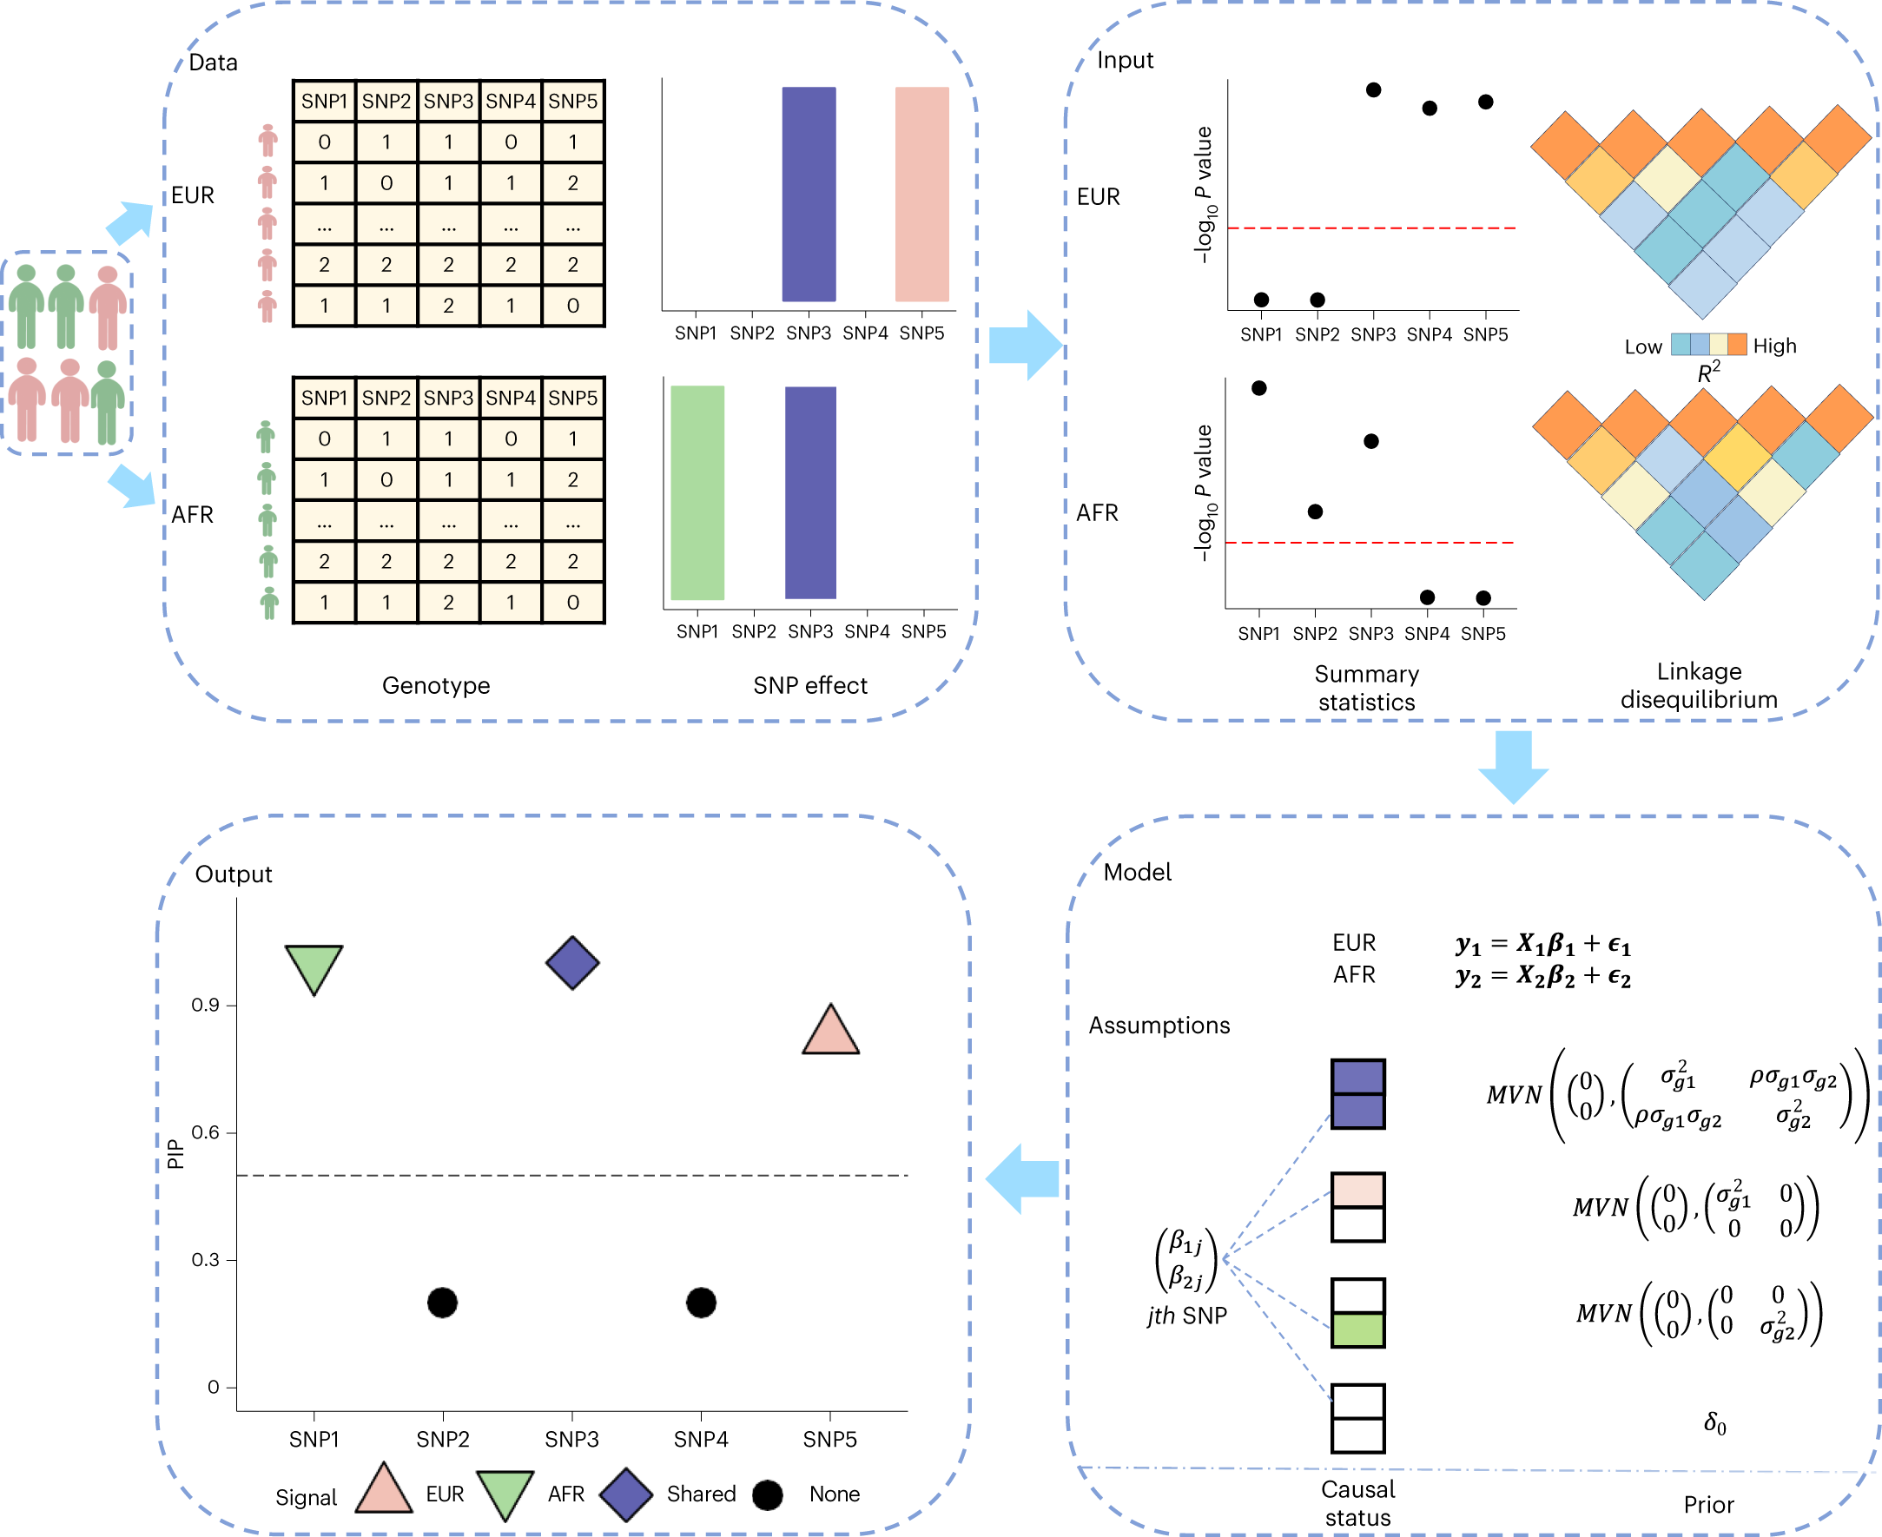
Background and motivation
Methods to interrogate GWAS signals
Statistical approaches using network agnostic information:
Effect sizes, allele frequencies and P-values
Haplotypes
Multi-ancestral GWAS
Gene region
Etc…
Notes:
Simple Explanation: The figure shows how many connections (edges) and elements (nodes) are in different parts of the interactome, which is a network of protein interactions. The largest component is from the STRING database, followed by the OTAR dataset. Smaller contributions come from IntAct, Reactome, and SIGNOR, showing how these sources combine to form a comprehensive network.

Slide 4
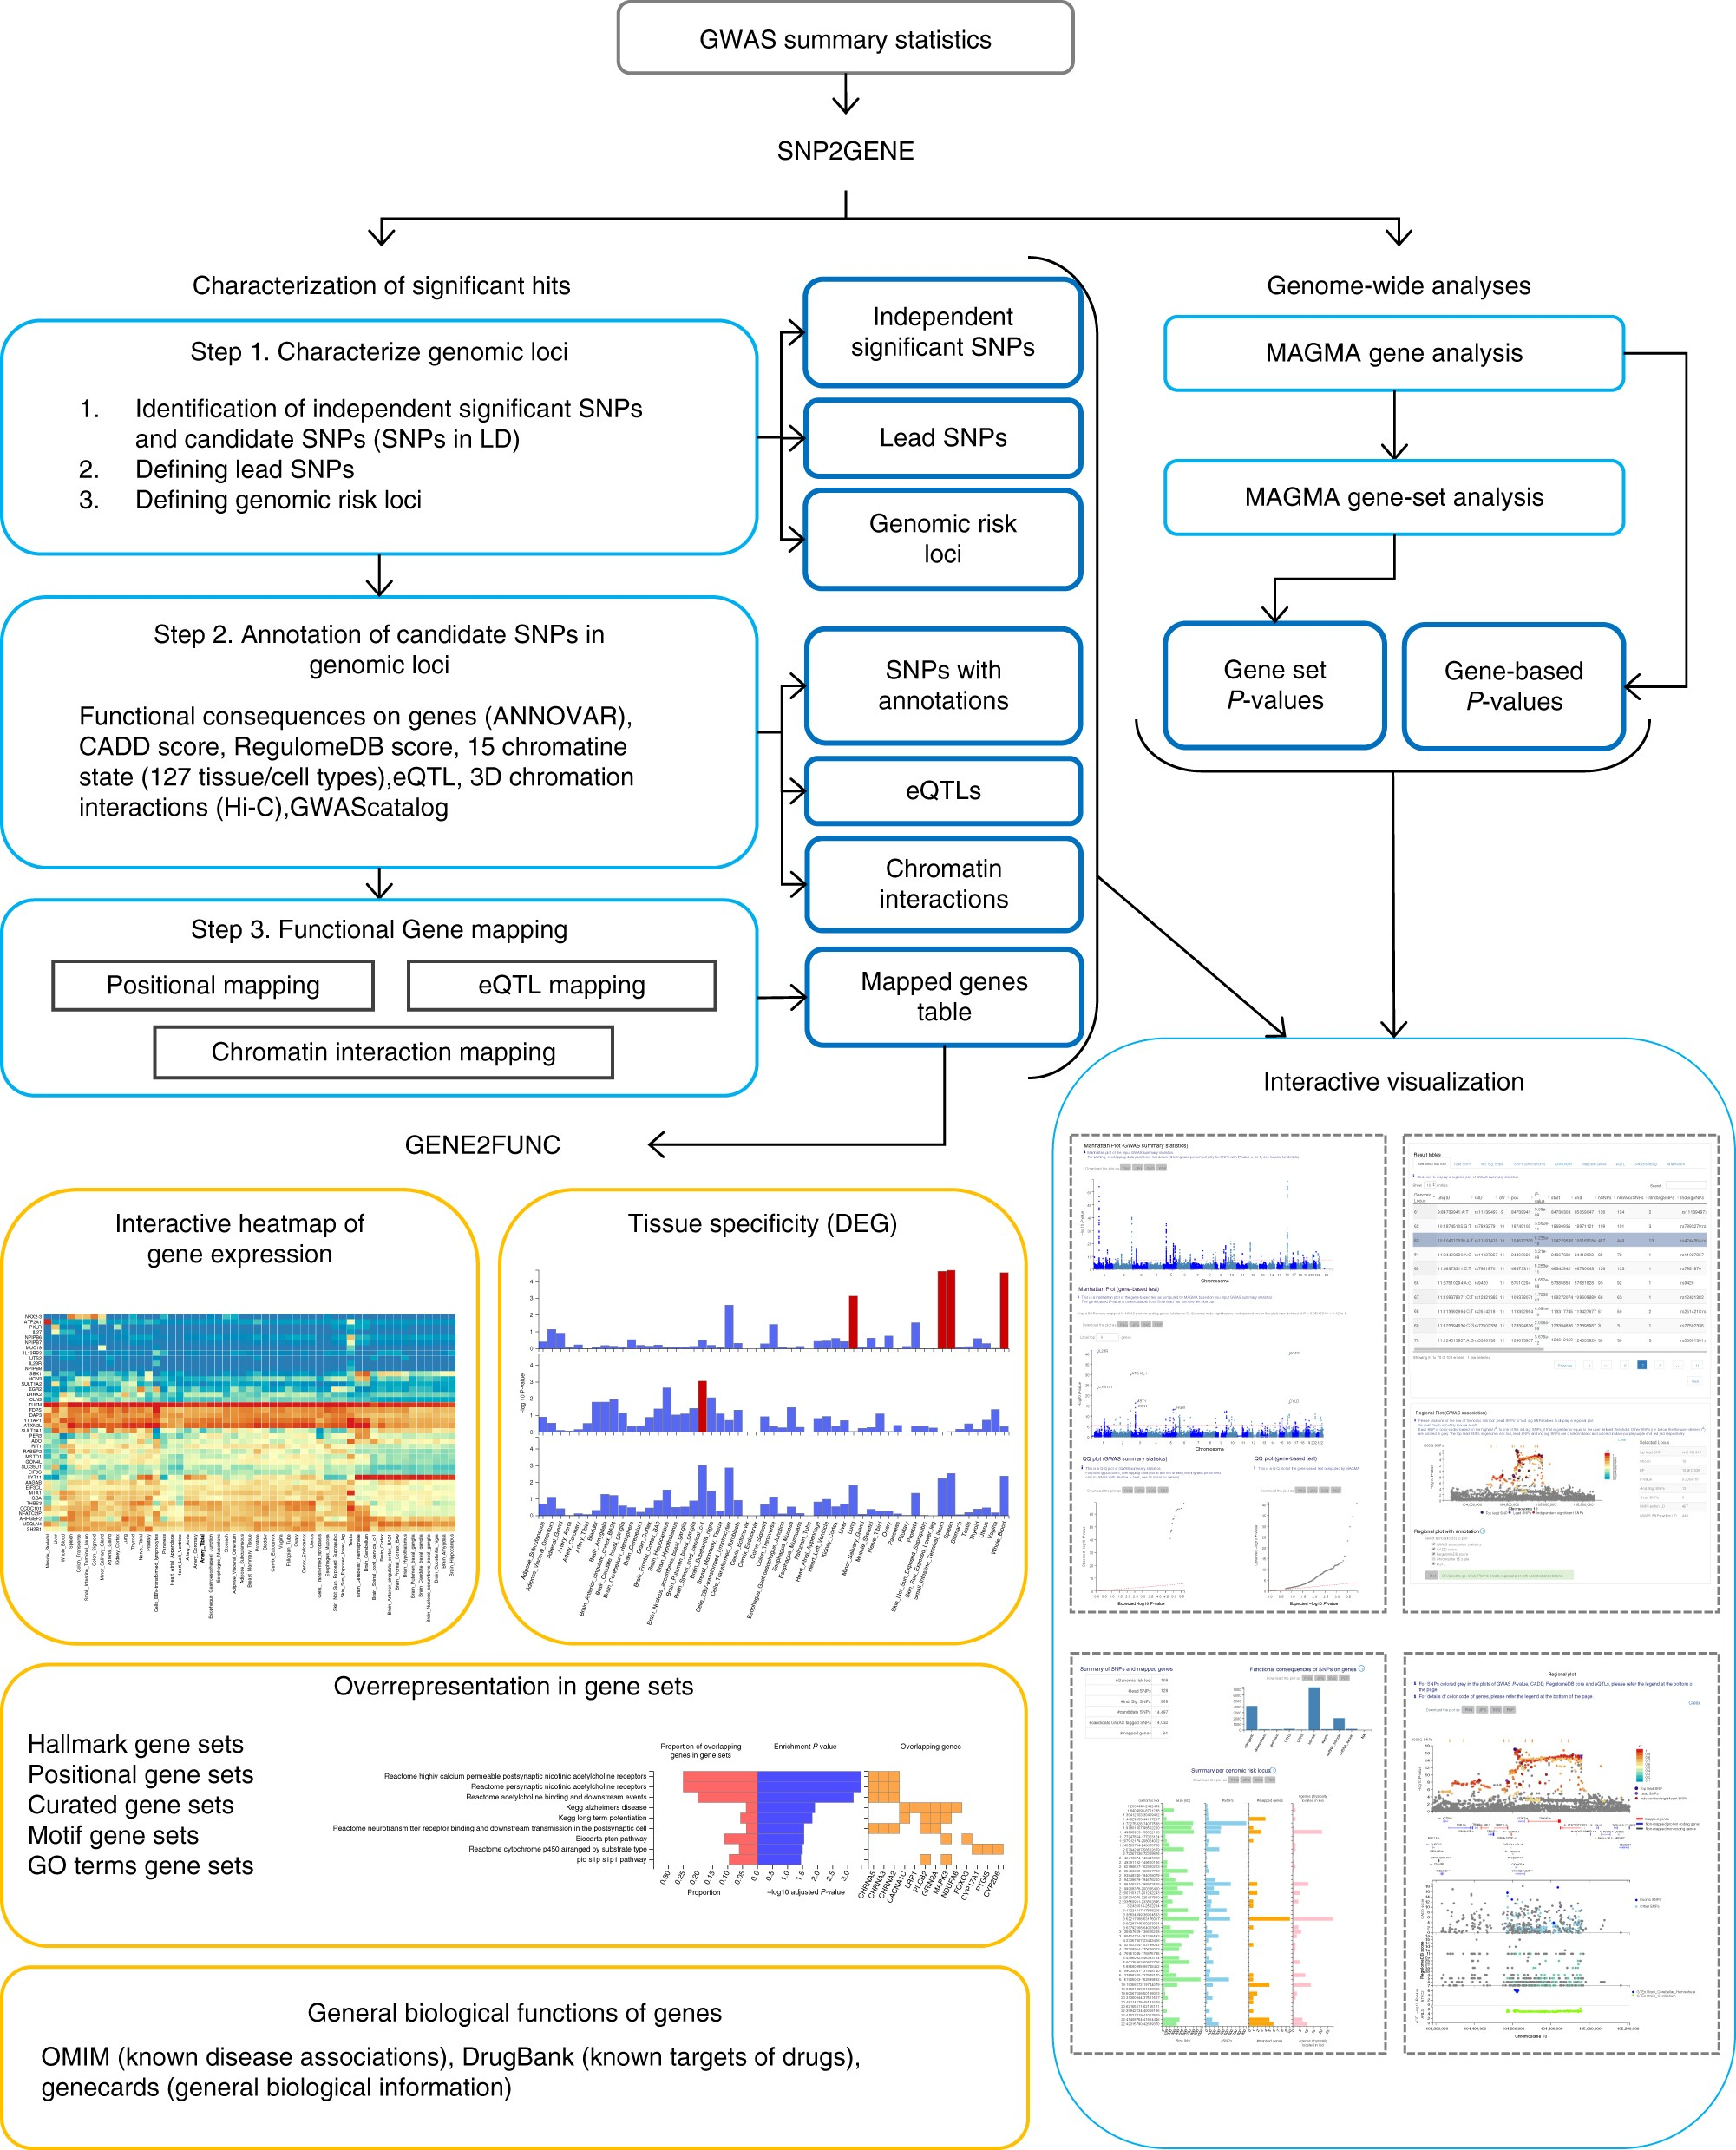
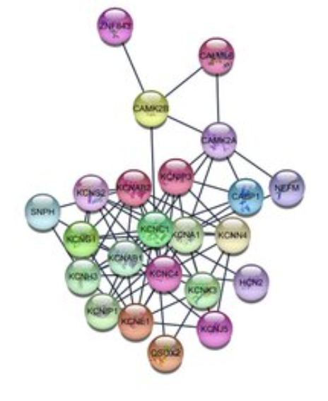
Background and motivation
Methods to interrogate GWAS signals
Biological Pathway/Network approaches using:
All information used in the network-agnostic approaches
Multi-Omics data
Biological networks (protein interactions, environmental effect…)
Notes:
Simple Explanation: The figure shows how many connections (edges) and elements (nodes) are in different parts of the interactome, which is a network of protein interactions. The largest component is from the STRING database, followed by the OTAR dataset. Smaller contributions come from IntAct, Reactome, and SIGNOR, showing how these sources combine to form a comprehensive network.

Slide 5
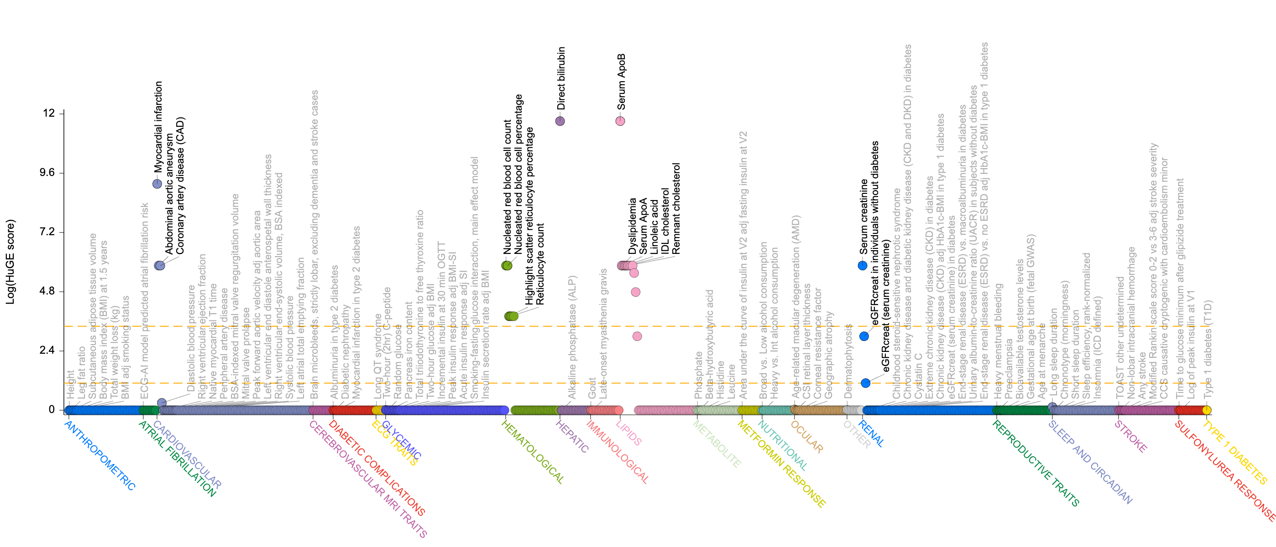
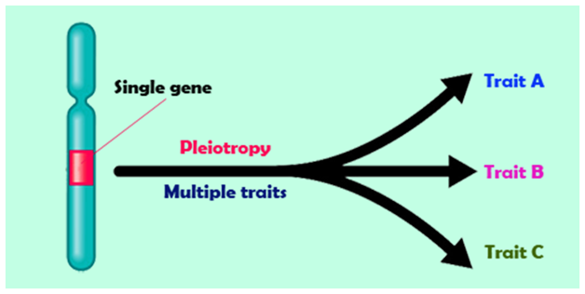
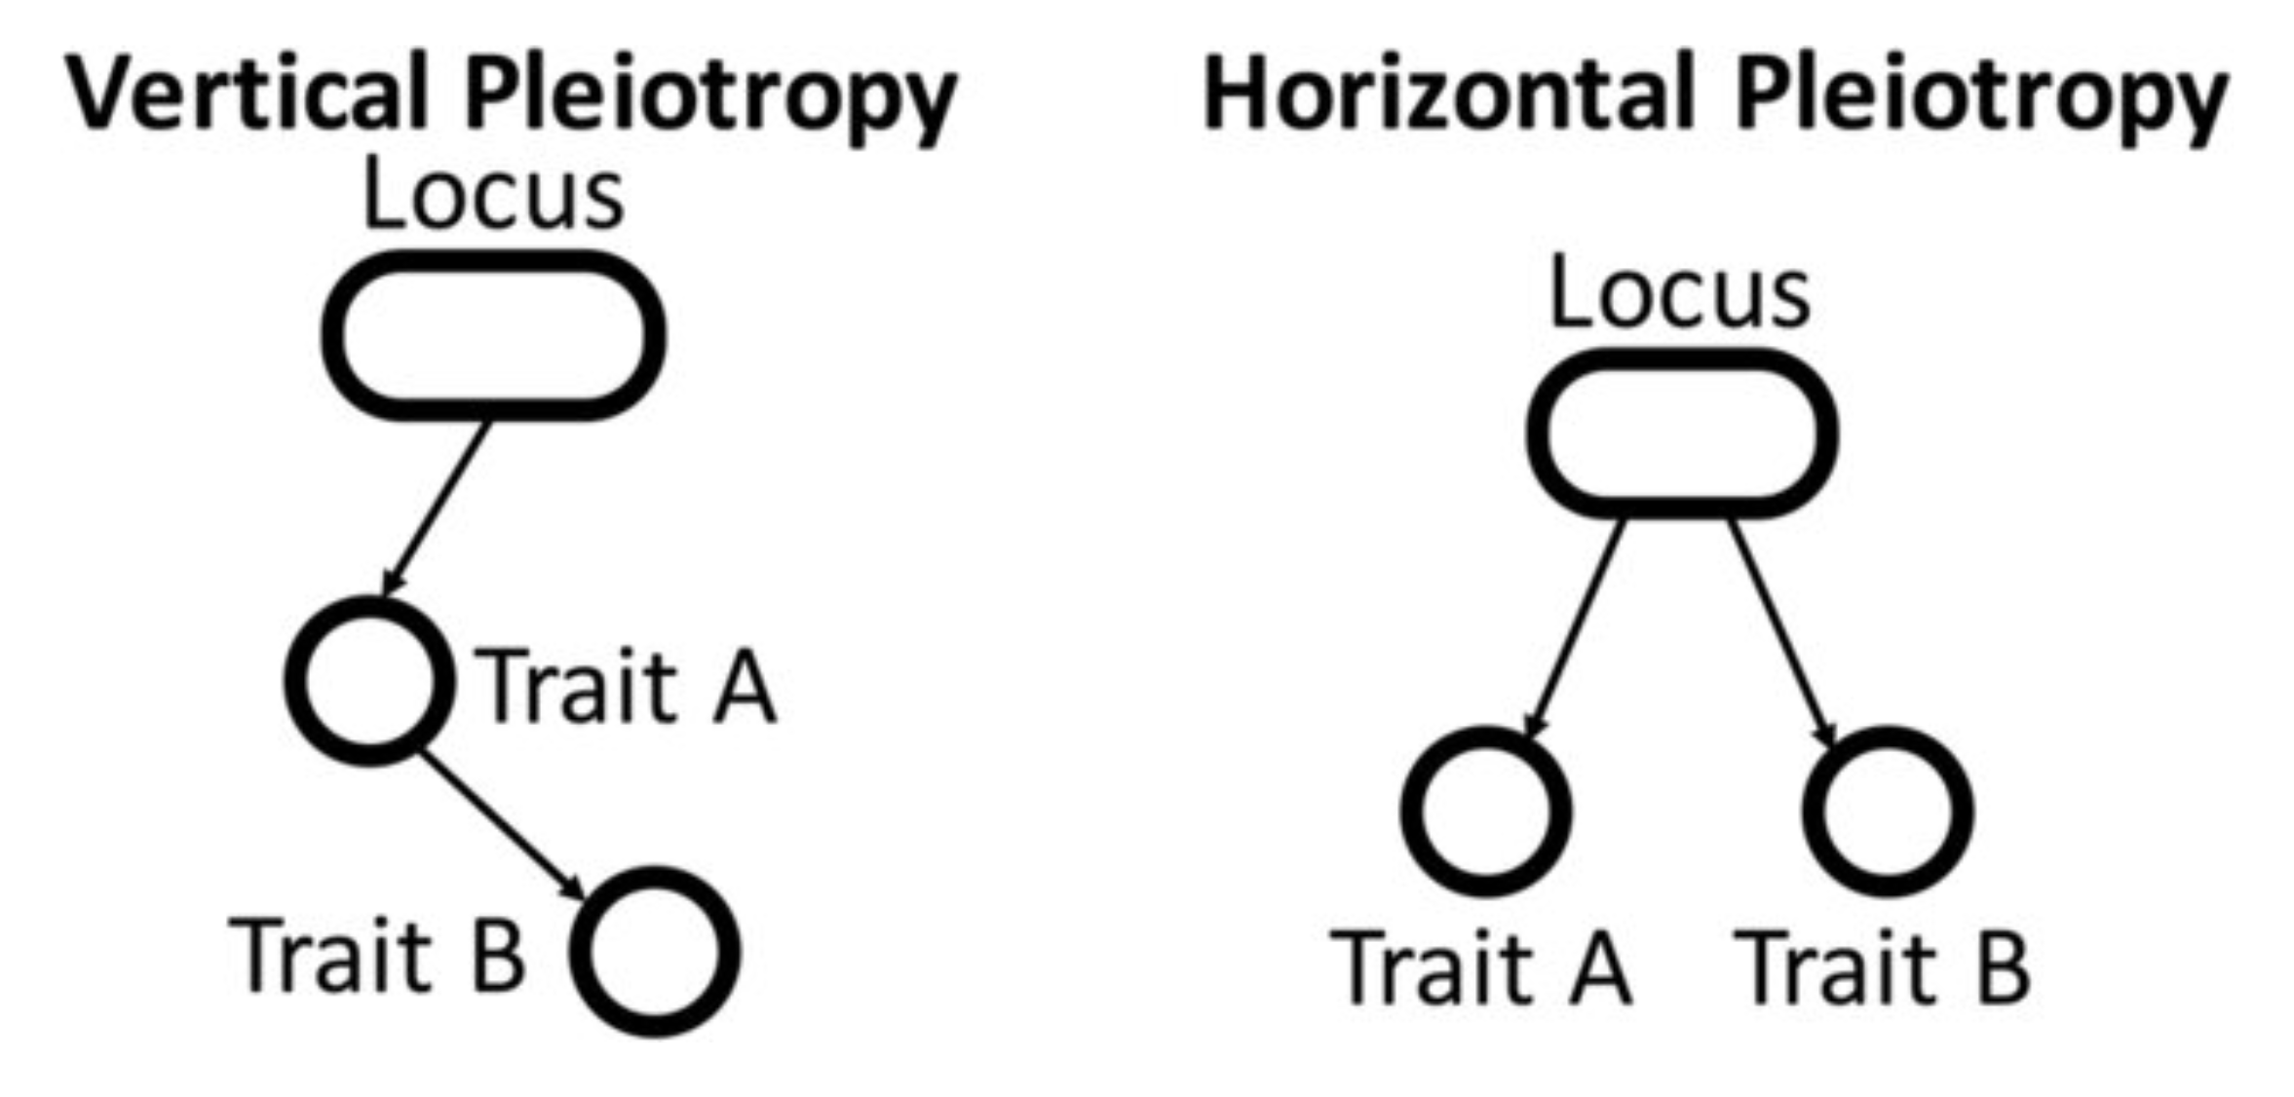
Background and motivation
Pleiotropy
a single gene or mutation influences multiple traits that appear to be unrelated
PCSK9 associations reported in Common Metabolic Diseases Knowledge Portal
Notes:
Simple Explanation: The figure shows how many connections (edges) and elements (nodes) are in different parts of the interactome, which is a network of protein interactions. The largest component is from the STRING database, followed by the OTAR dataset. Smaller contributions come from IntAct, Reactome, and SIGNOR, showing how these sources combine to form a comprehensive network.

Slide 6
Background and motivation
GWAS typically identifies variants with small effects that often exhibit pleiotropy.
A complete biological network has not yet been utilized to analyze GWAS associations.
SNP to gene is the most important
Investigating pleiotropy is crucial for uncovering core biological principles and for drug repurposing efforts.
Notes:
Simple Explanation: The figure shows how many connections (edges) and elements (nodes) are in different parts of the interactome, which is a network of protein interactions. The largest component is from the STRING database, followed by the OTAR dataset. Smaller contributions come from IntAct, Reactome, and SIGNOR, showing how these sources combine to form a comprehensive network.

Slide 7
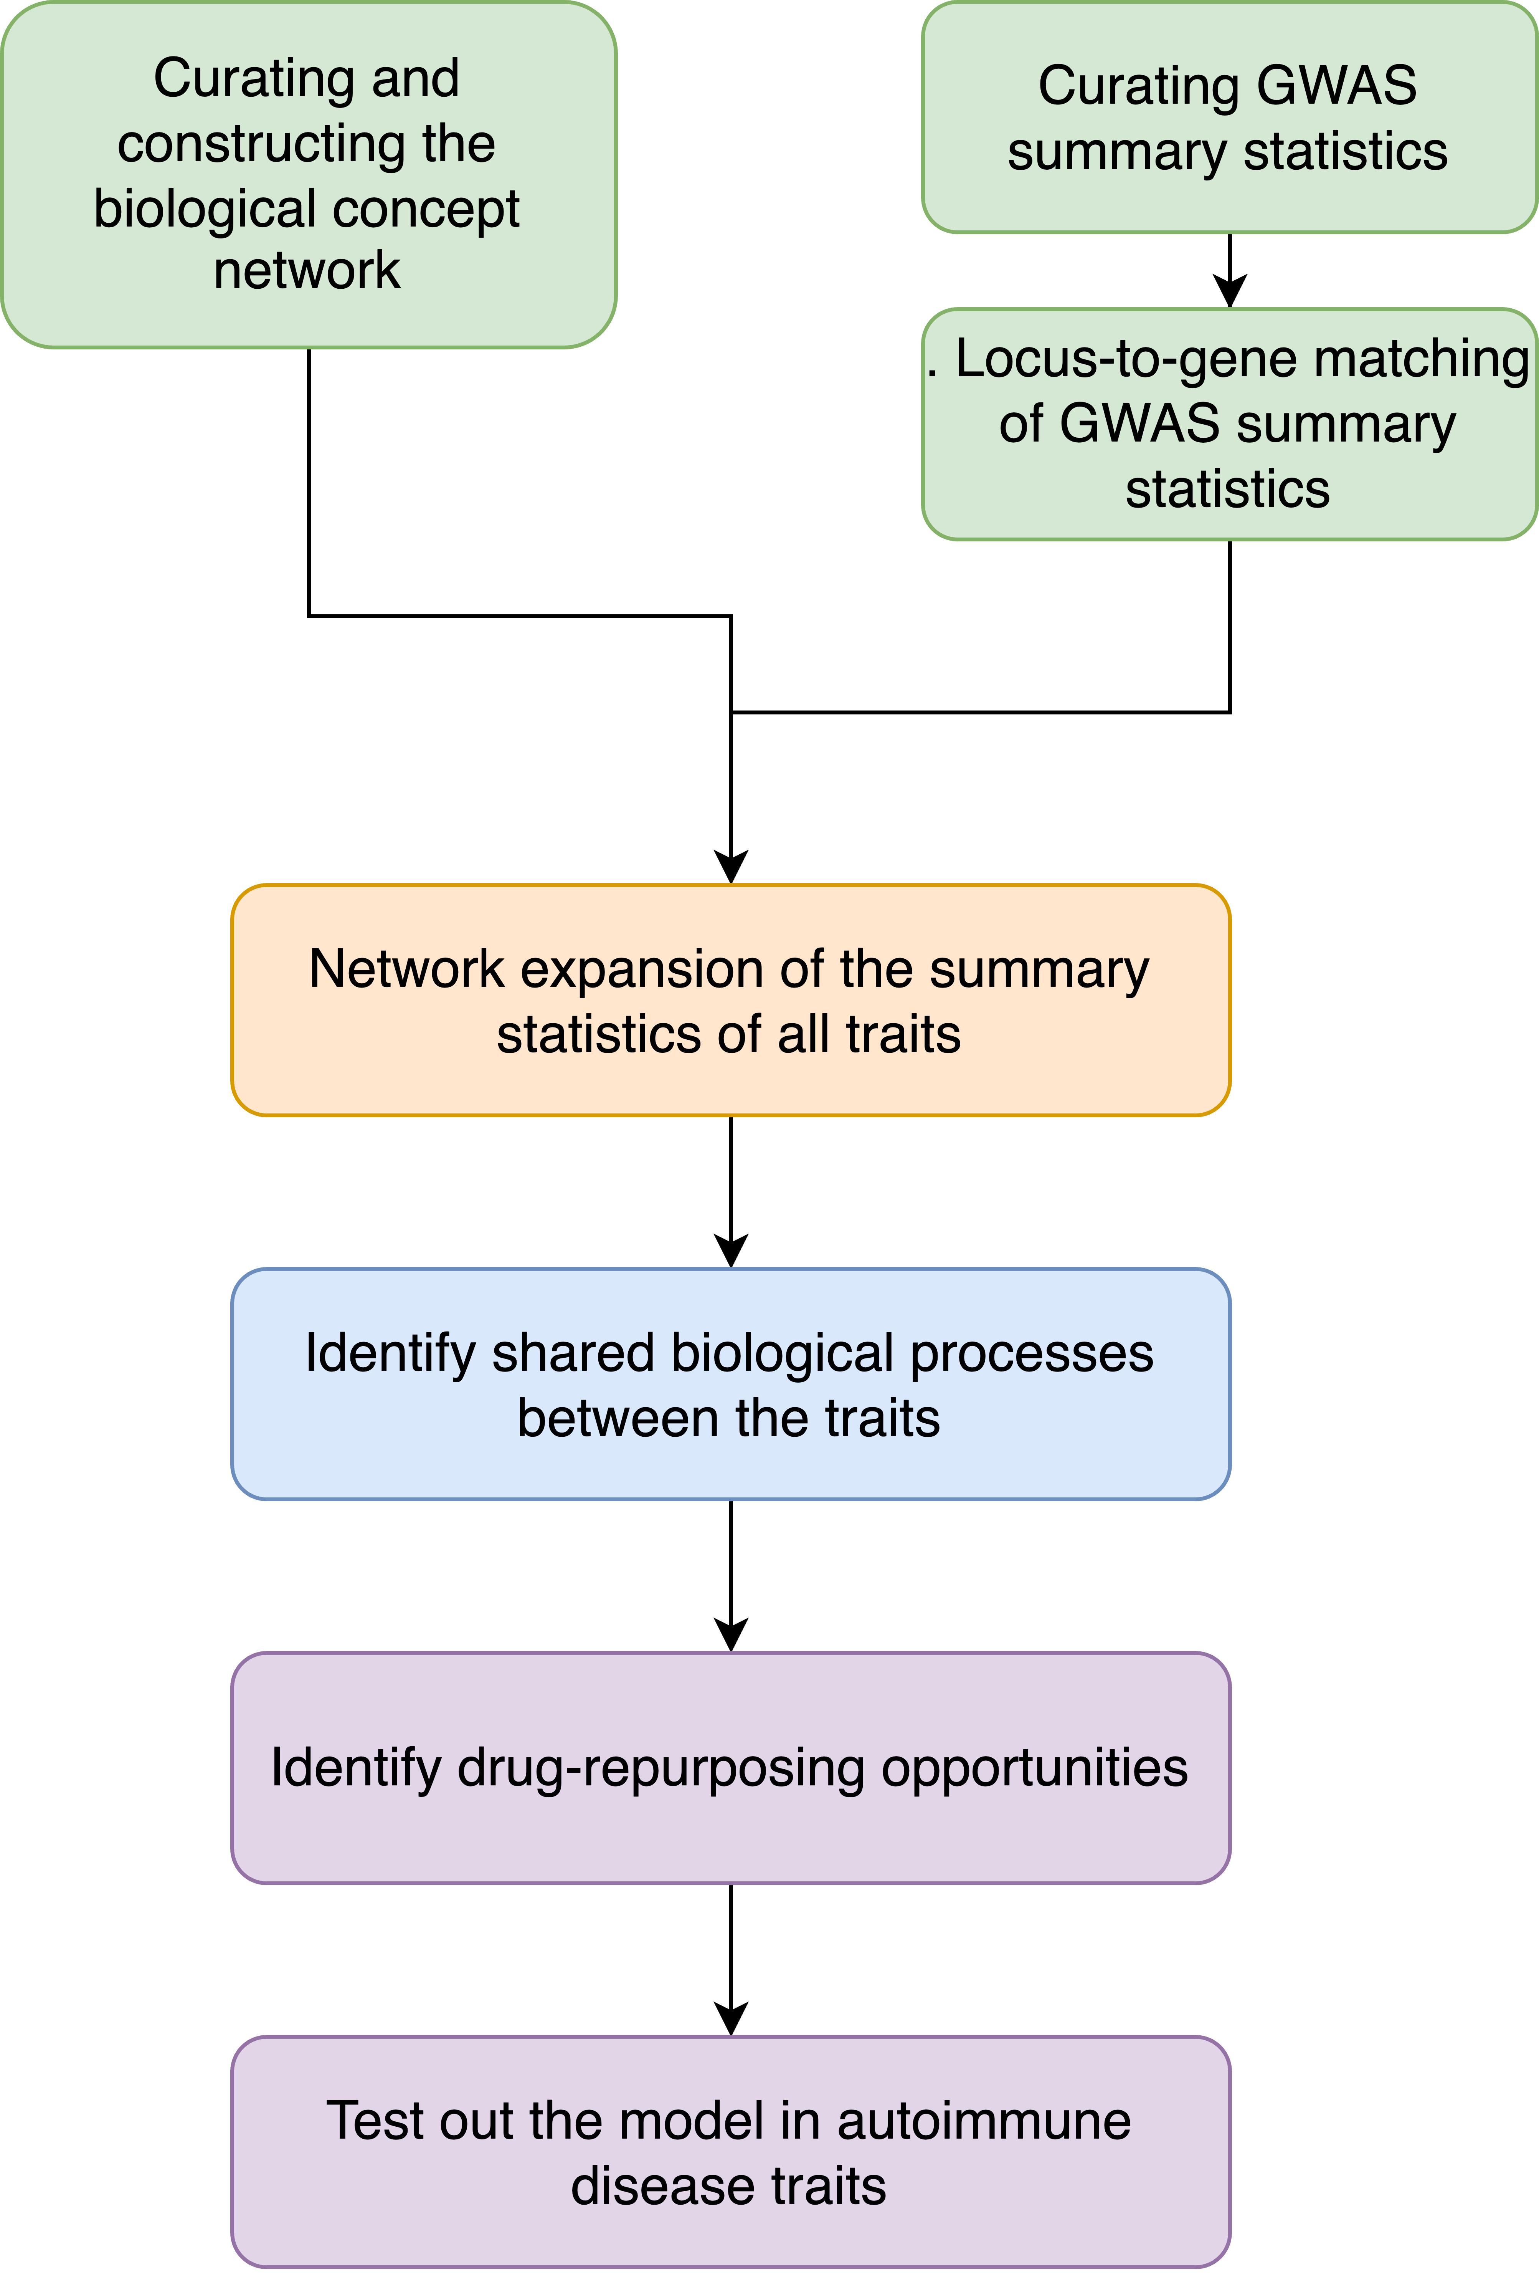
Schematics of the Study
Notes:
Simple Explanation: The figure shows how many connections (edges) and elements (nodes) are in different parts of the interactome, which is a network of protein interactions. The largest component is from the STRING database, followed by the OTAR dataset. Smaller contributions come from IntAct, Reactome, and SIGNOR, showing how these sources combine to form a comprehensive network.

Slide 8
Component of the Knowledge Graph
Notes:
Simple Explanation: The figure shows how many connections (edges) and elements (nodes) are in different parts of the interactome, which is a network of protein interactions. The largest component is from the STRING database, followed by the OTAR dataset. Smaller contributions come from IntAct, Reactome, and SIGNOR, showing how these sources combine to form a comprehensive network.

Slide 9
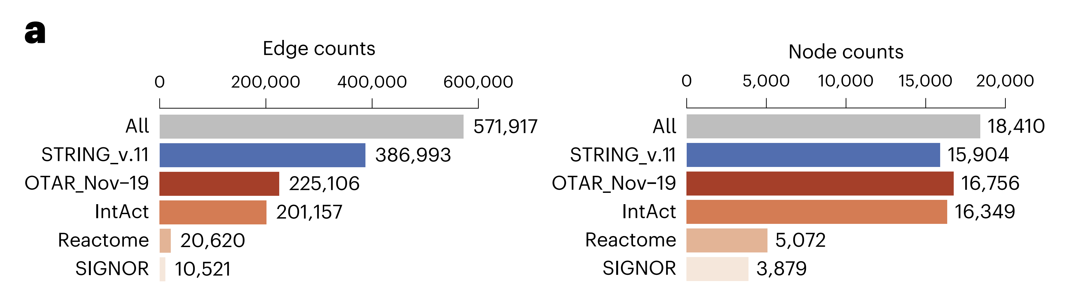
Edge and Node Counts of the Combined Interactome
Description: This panel compares the number of edges (left) and nodes (right) in different components of the combined interactome.
Notes:
Simple Explanation: The figure shows how many connections (edges) and elements (nodes) are in different parts of the interactome, which is a network of protein interactions. The largest component is from the STRING database, followed by the OTAR dataset. Smaller contributions come from IntAct, Reactome, and SIGNOR, showing how these sources combine to form a comprehensive network.

Slide 10
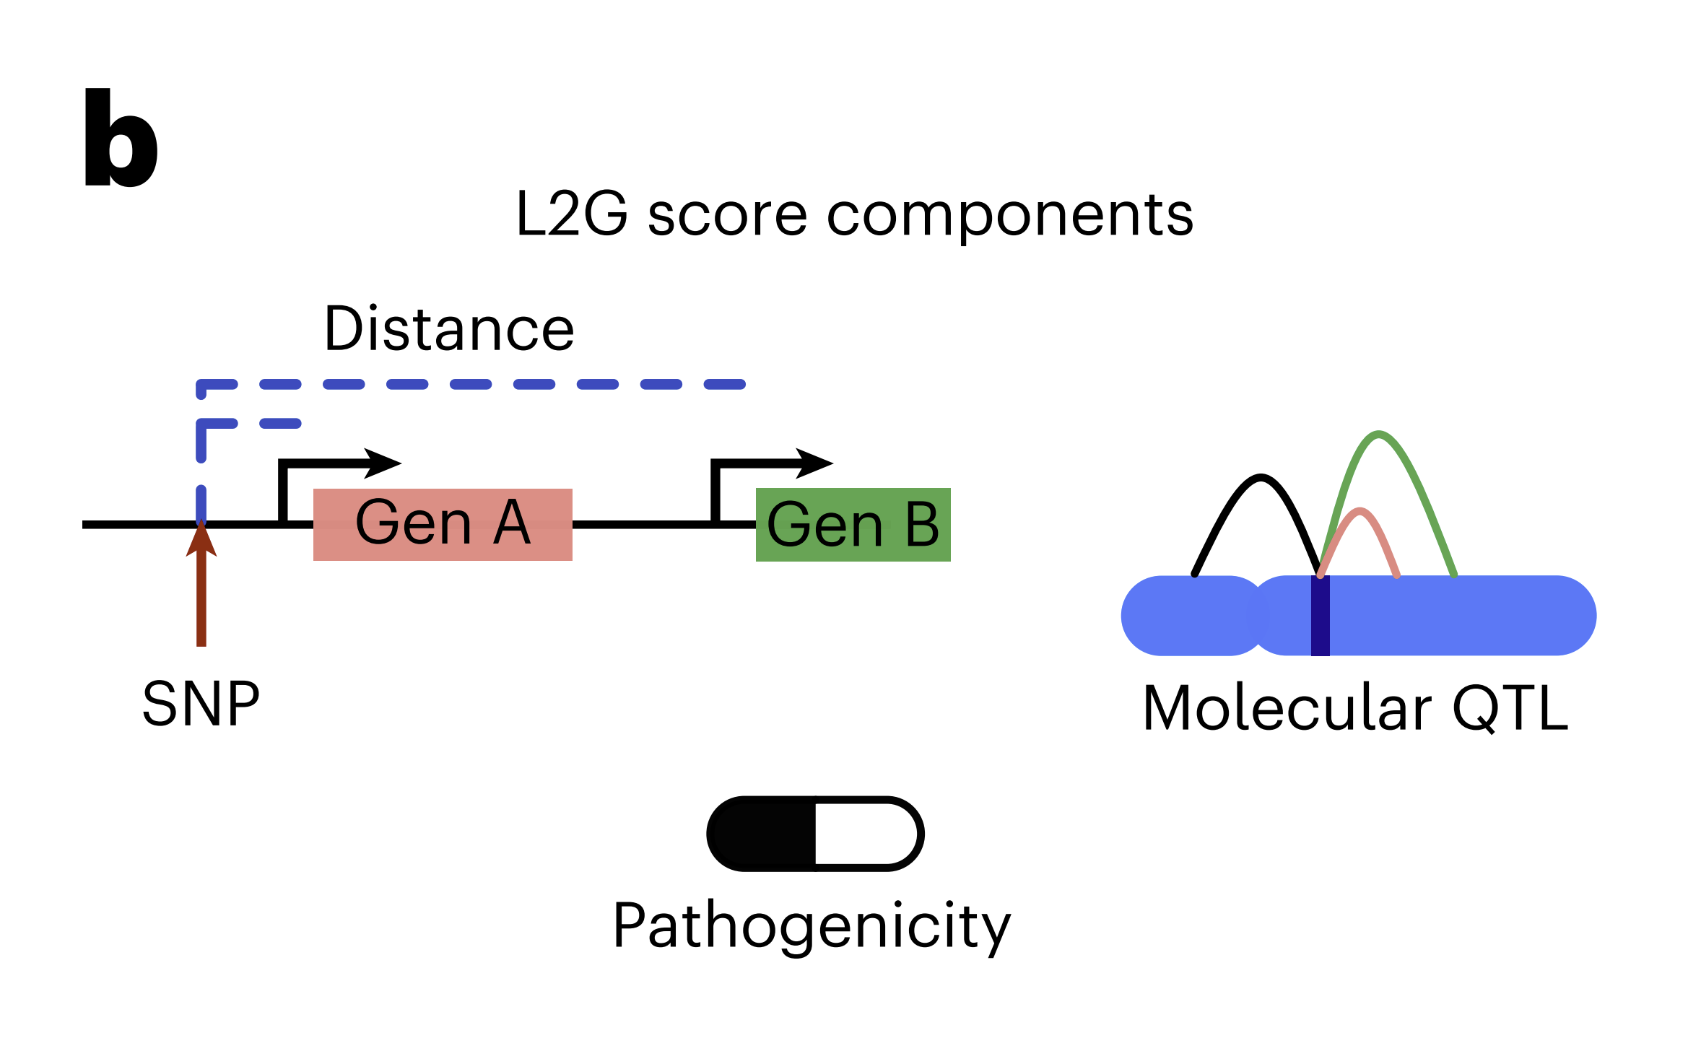
Locus to Gene Score Components
Description: This panel graphically represents the components that contribute to the Locus-to-Gene (L2G) score, including SNP-to-gene distance, molecular QTL, and pathogenicity predictions.
Notes:
Simple Explanation: This panel shows the factors considered when predicting which genes might be causing a trait based on genetic data. It includes how close a genetic variant (SNP) is to a gene, how this affects the gene’s expression, and how likely the gene is to be involved in disease.

Slide 11
Schematics of the Study
Notes:
Simple Explanation: The figure shows how many connections (edges) and elements (nodes) are in different parts of the interactome, which is a network of protein interactions. The largest component is from the STRING database, followed by the OTAR dataset. Smaller contributions come from IntAct, Reactome, and SIGNOR, showing how these sources combine to form a comprehensive network.

Slide 12
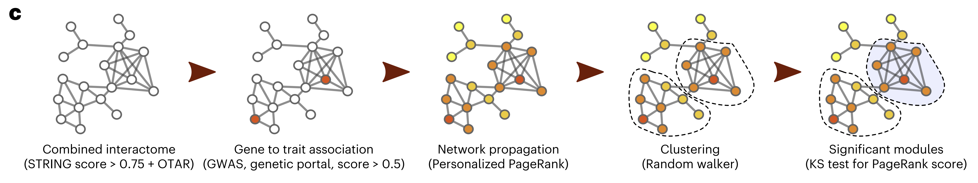
Network Expansion
Description: This panel outlines the network-based method used to expand GWAS results, starting from combining interactome data, linking genes to traits, propagating this information through the network, clustering gene communities, and identifying significant modules.
Notes:
Simple Explanation: This part explains the steps taken to use a network of protein interactions to find new genes that might be linked to traits or diseases. It starts by connecting genes to traits, spreads this information through the network, groups similar genes together, and then identifies the most important gene groups.

Slide 13
1002 Traits Clustered Based on Network Expansion
Notes:
Simple Explanation: The figure shows how many connections (edges) and elements (nodes) are in different parts of the interactome, which is a network of protein interactions. The largest component is from the STRING database, followed by the OTAR dataset. Smaller contributions come from IntAct, Reactome, and SIGNOR, showing how these sources combine to form a comprehensive network.

Slide 14
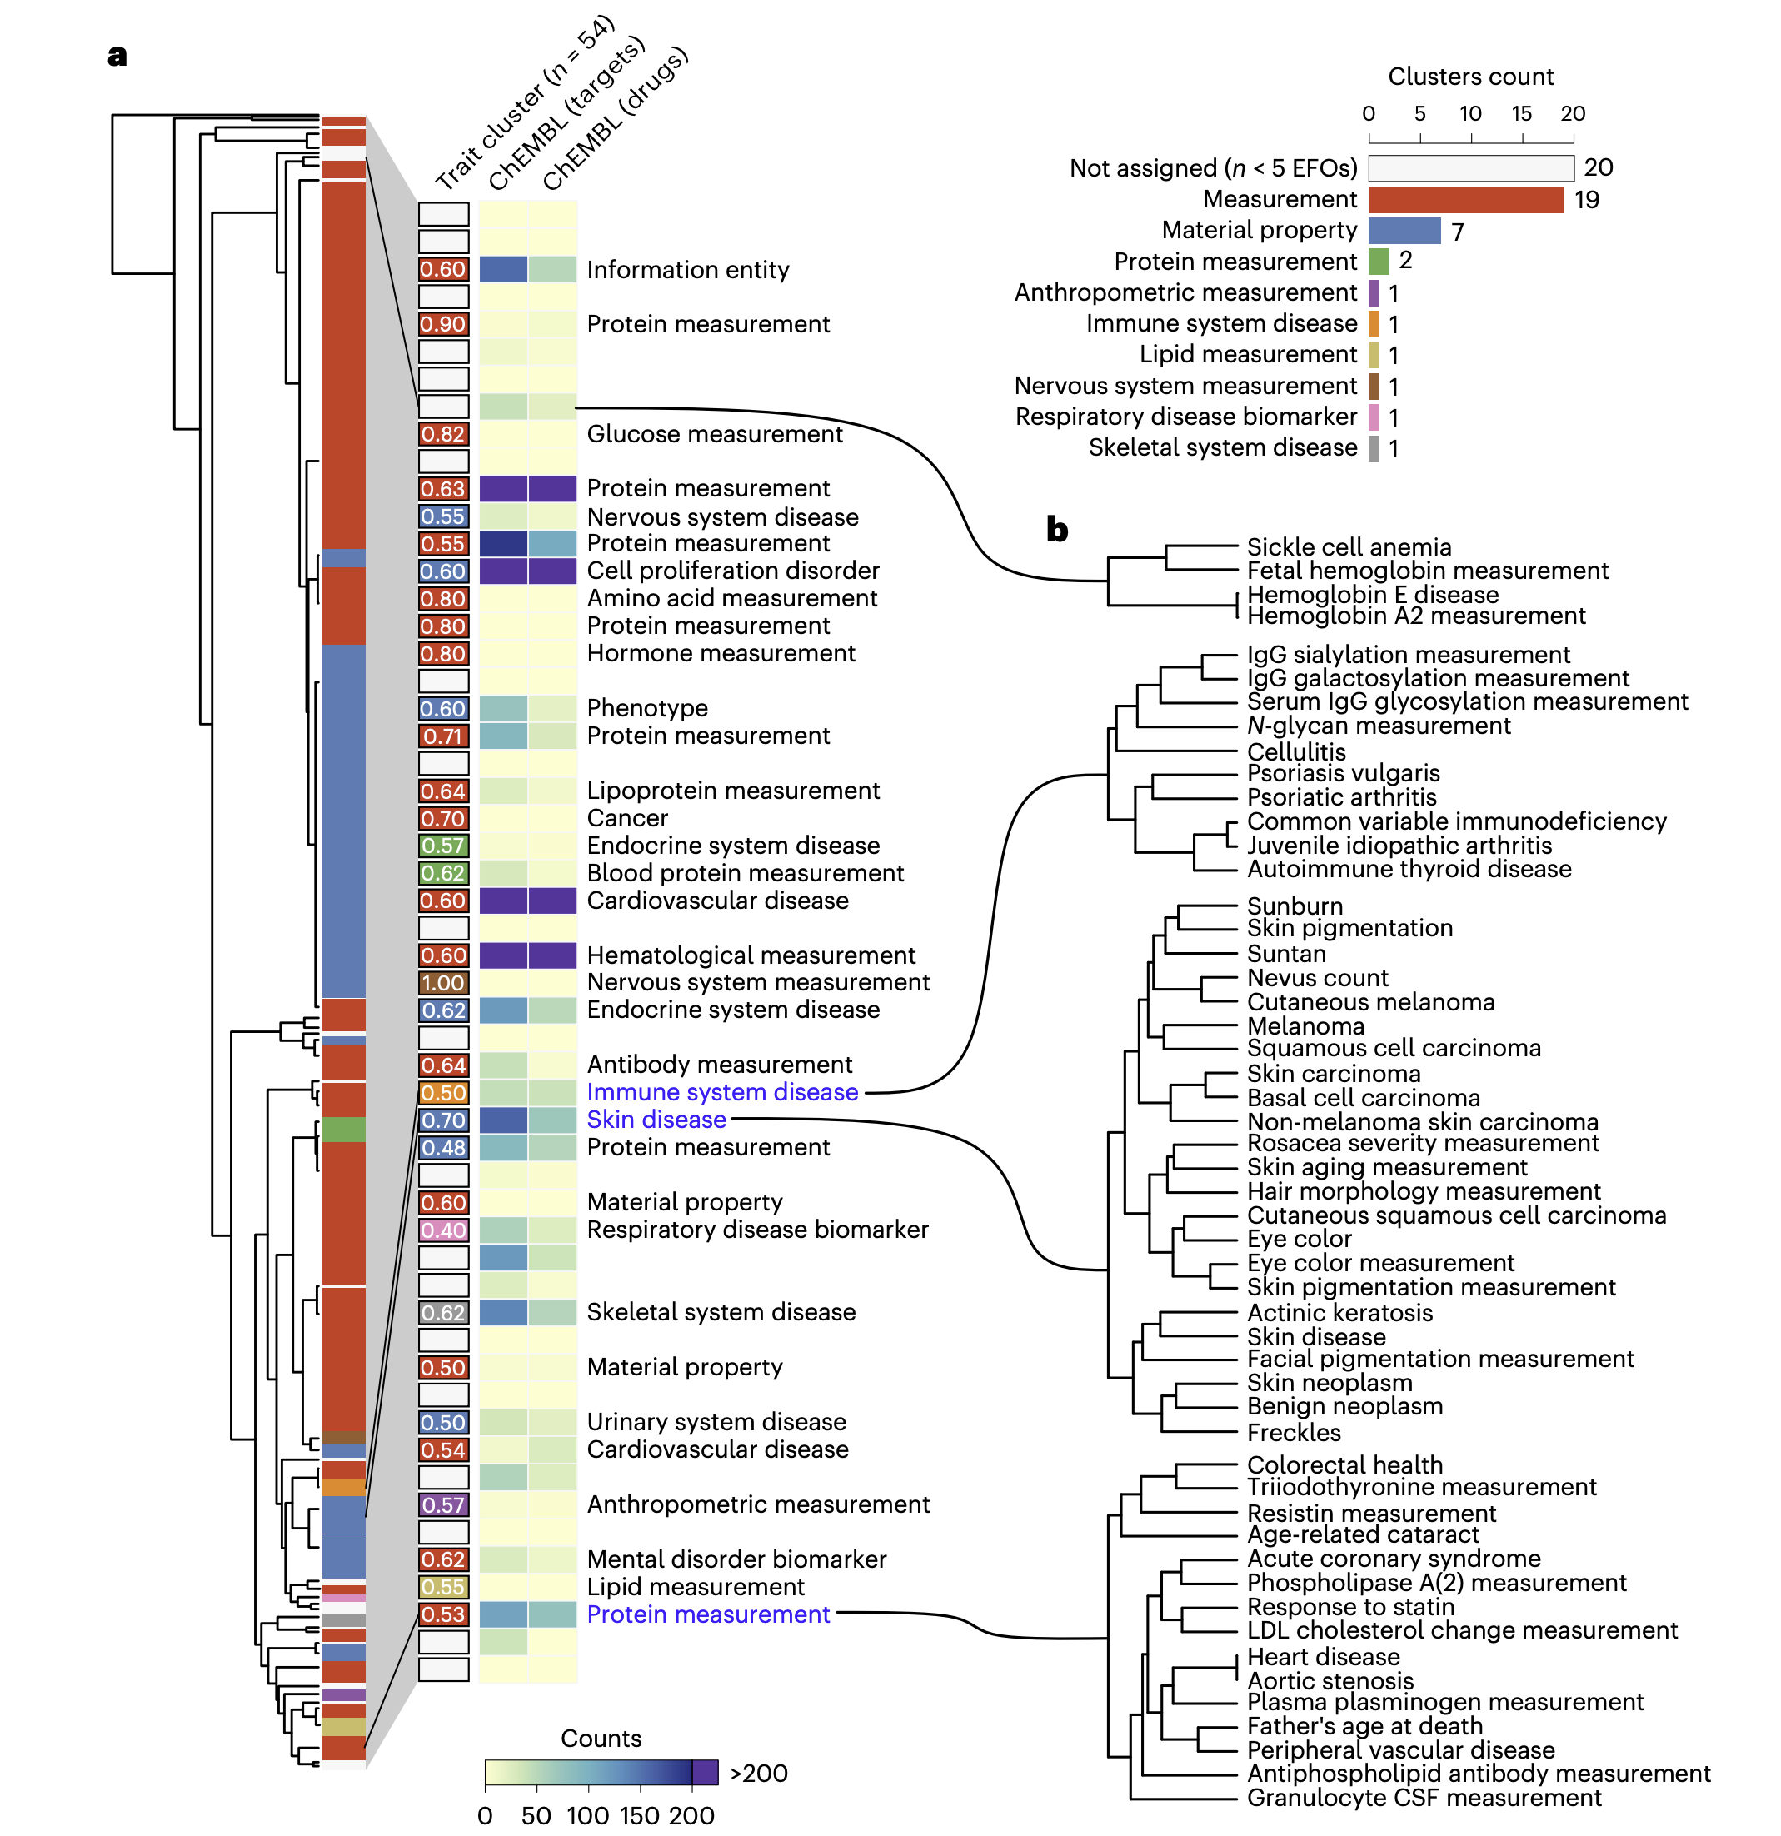
Panel a: Trait Clusters Based on Network Expansion Scores
Dendrogram of the hierarchical clustering of 1,002 traits based on their network propagation scores.
Traits are grouped into 54 clusters,
Notes:
Simple Explanation: The tree shows how different traits or diseases are related based on the genes they share. By looking at how these traits group together, scientists can see which traits might have similar genetic causes. The heatmap highlights how these groups of traits fall into different categories, like measurements, diseases, or other characteristics.

Slide 15
Panel a: Trait Clusters Based on Network Expansion Scores
The heatmap on the right shows the distribution of these clusters across different EFO categories.

Slide 16
Schematics of the Study
Notes:
Simple Explanation: The figure shows how many connections (edges) and elements (nodes) are in different parts of the interactome, which is a network of protein interactions. The largest component is from the STRING database, followed by the OTAR dataset. Smaller contributions come from IntAct, Reactome, and SIGNOR, showing how these sources combine to form a comprehensive network.

Slide 17
Network Expansion Reveals Pleiotropic Gene Modules
Notes:
Simple Explanation: The figure shows how many connections (edges) and elements (nodes) are in different parts of the interactome, which is a network of protein interactions. The largest component is from the STRING database, followed by the OTAR dataset. Smaller contributions come from IntAct, Reactome, and SIGNOR, showing how these sources combine to form a comprehensive network.

Slide 18
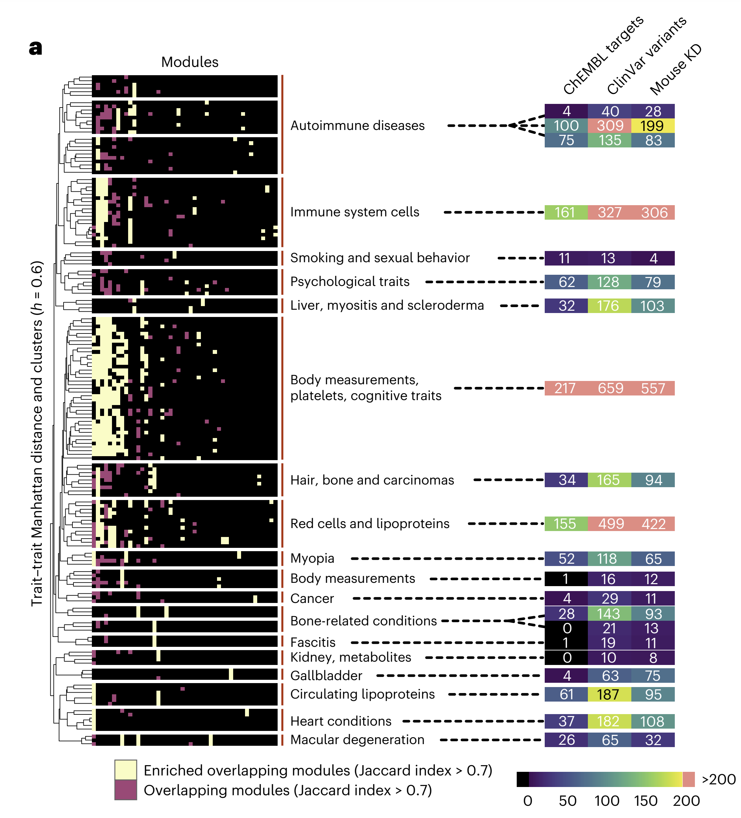
Overlap Between Gene Modules Across Traits
Overlap between gene modules associated with various traits.
Modules that overlap significantly across traits are highlighted
The right-hand panel shows the number of genes in modules from each subgroup of traits that are drug targets, linked with clinical variants or with mouse KO phenotypes.
Notes:
Simple Explanation: This heatmap shows how groups of genes linked to different traits overlap with each other. It highlights areas where certain diseases or traits share a lot of genes, suggesting they might be connected through similar biological processes. For example, traits like autoimmune diseases, immune system cells, and psychological traits are grouped together, indicating potential shared genetic factors.

Slide 19
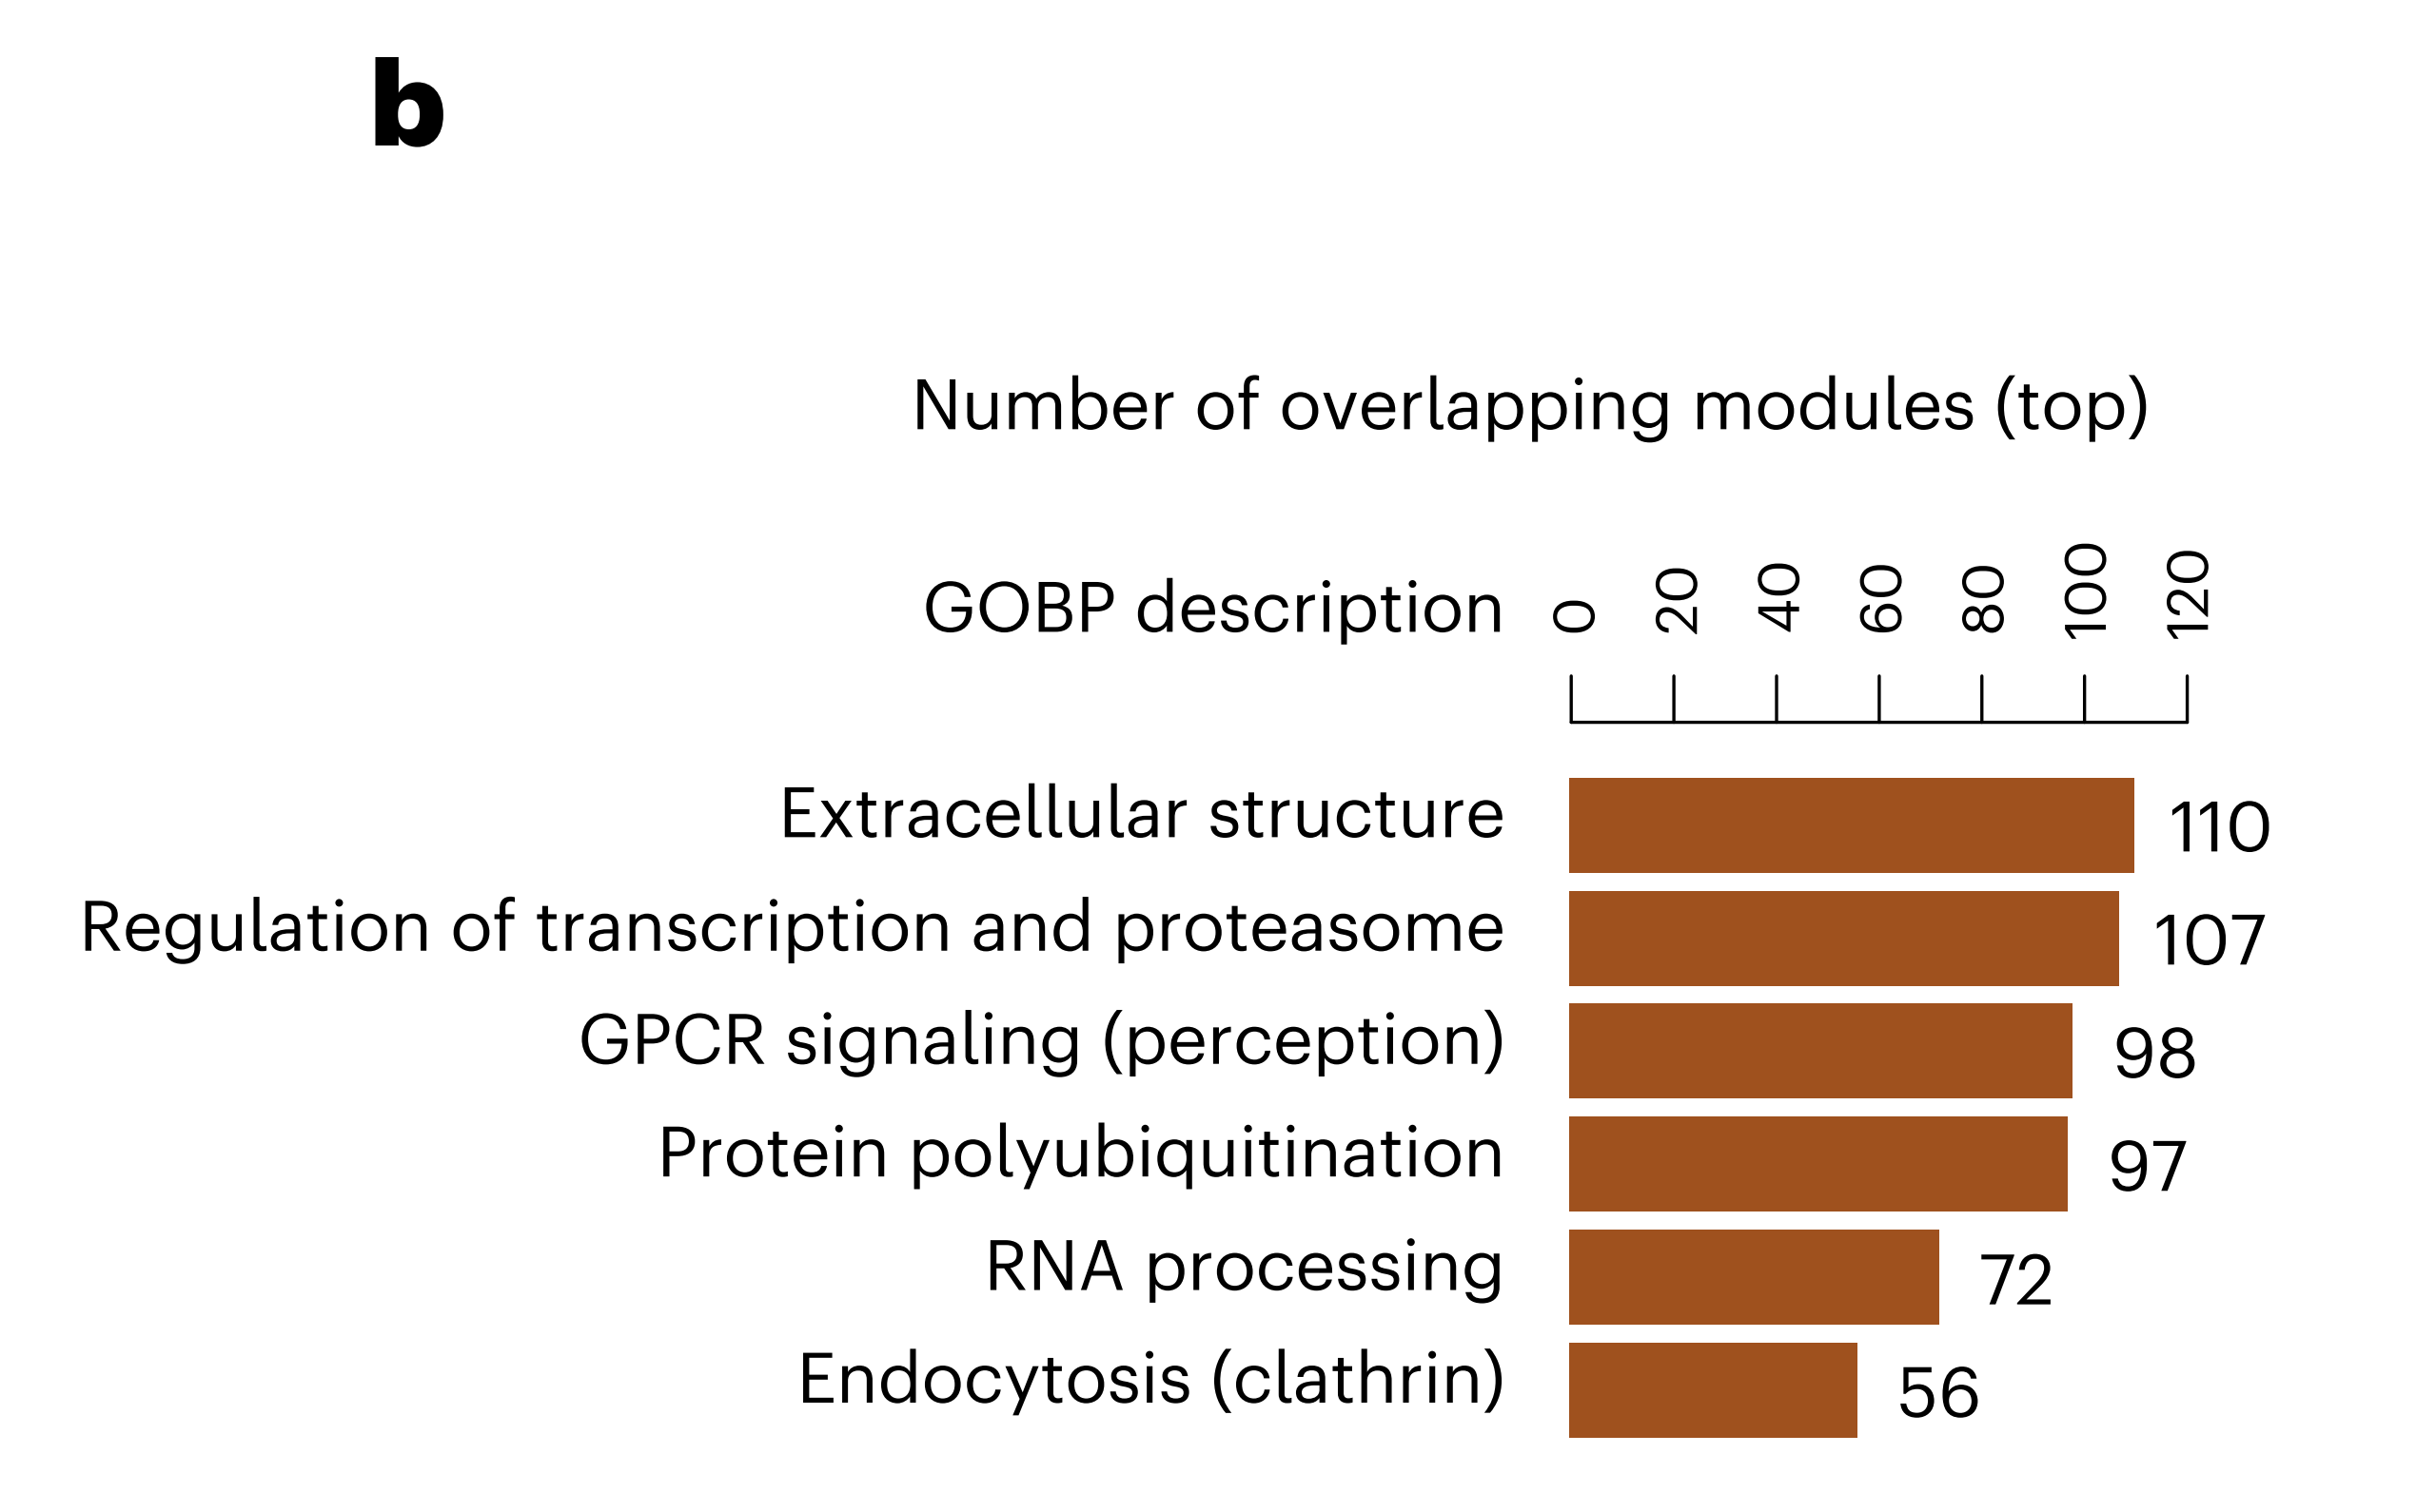
Most Pleiotropic Gene Modules
Overlapping gene modules across different traits and highlights the six most pleiotropic modules.
Notes:
Simple Explanation: This barplot identifies the gene groups that are involved in the most different traits. The figure emphasizes that certain biological processes, like how cells communicate or how proteins are modified, are common to many different diseases or traits, making them key areas to study for potential treatments.

Slide 20
Network of Gene Modules in Immune Traits and Diseases
Notes:
Simple Explanation: The figure shows how many connections (edges) and elements (nodes) are in different parts of the interactome, which is a network of protein interactions. The largest component is from the STRING database, followed by the OTAR dataset. Smaller contributions come from IntAct, Reactome, and SIGNOR, showing how these sources combine to form a comprehensive network.

Slide 21
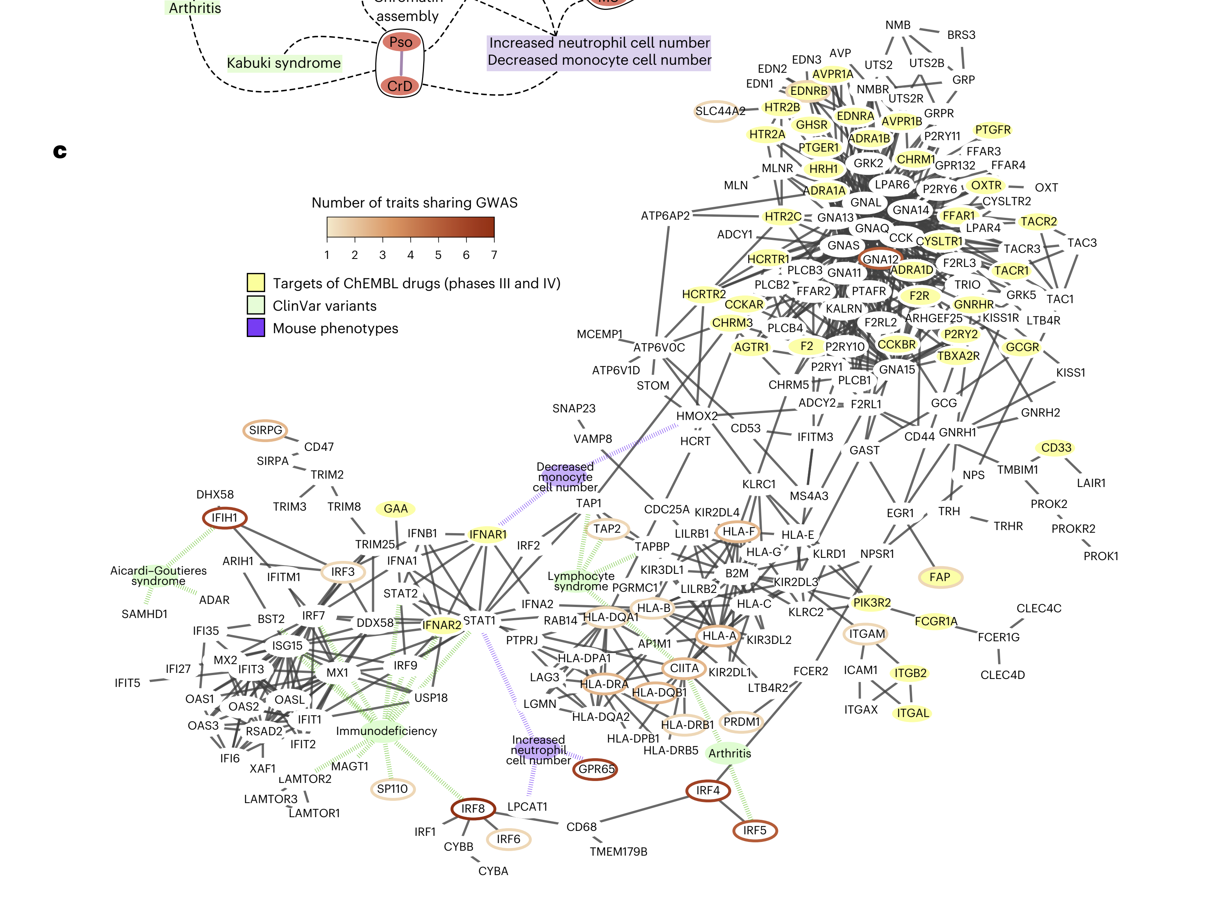
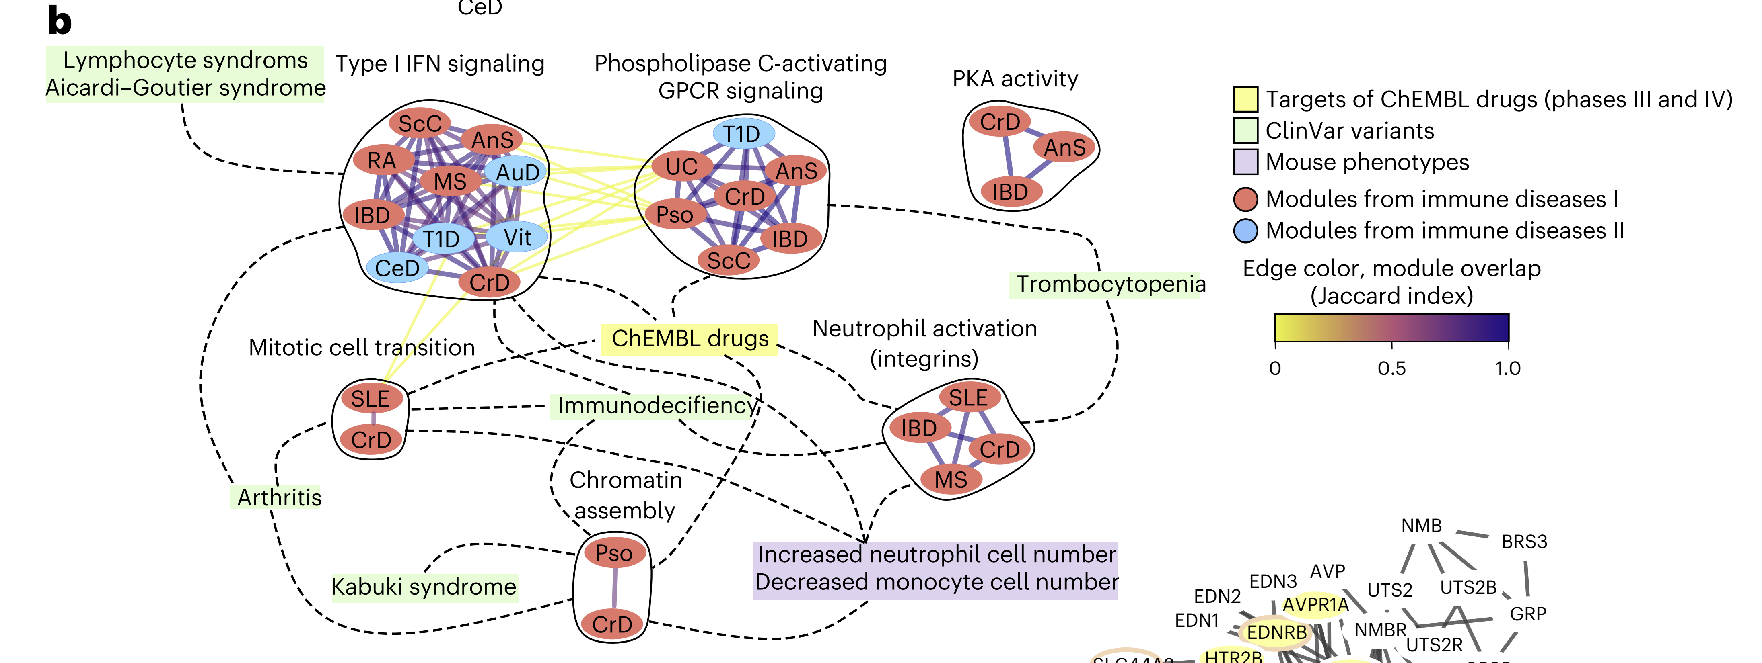
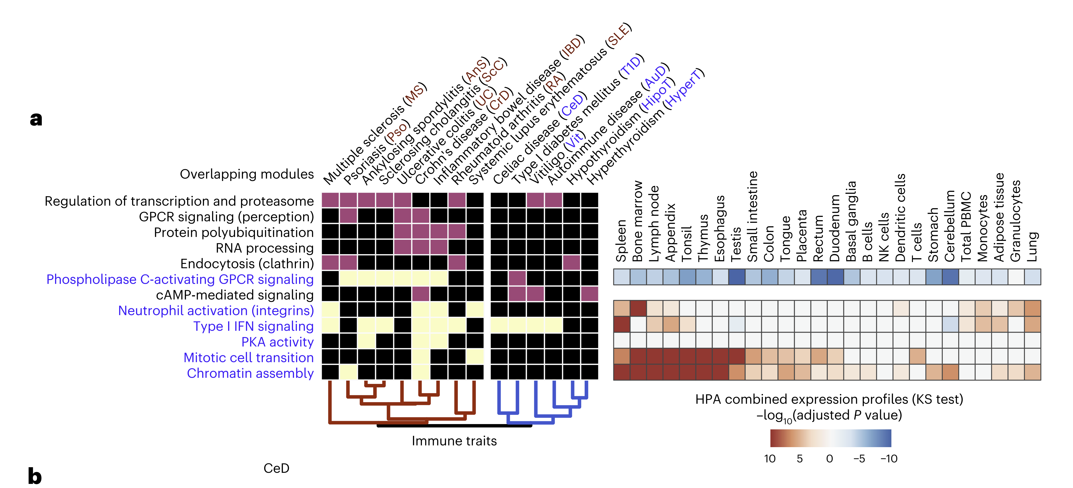
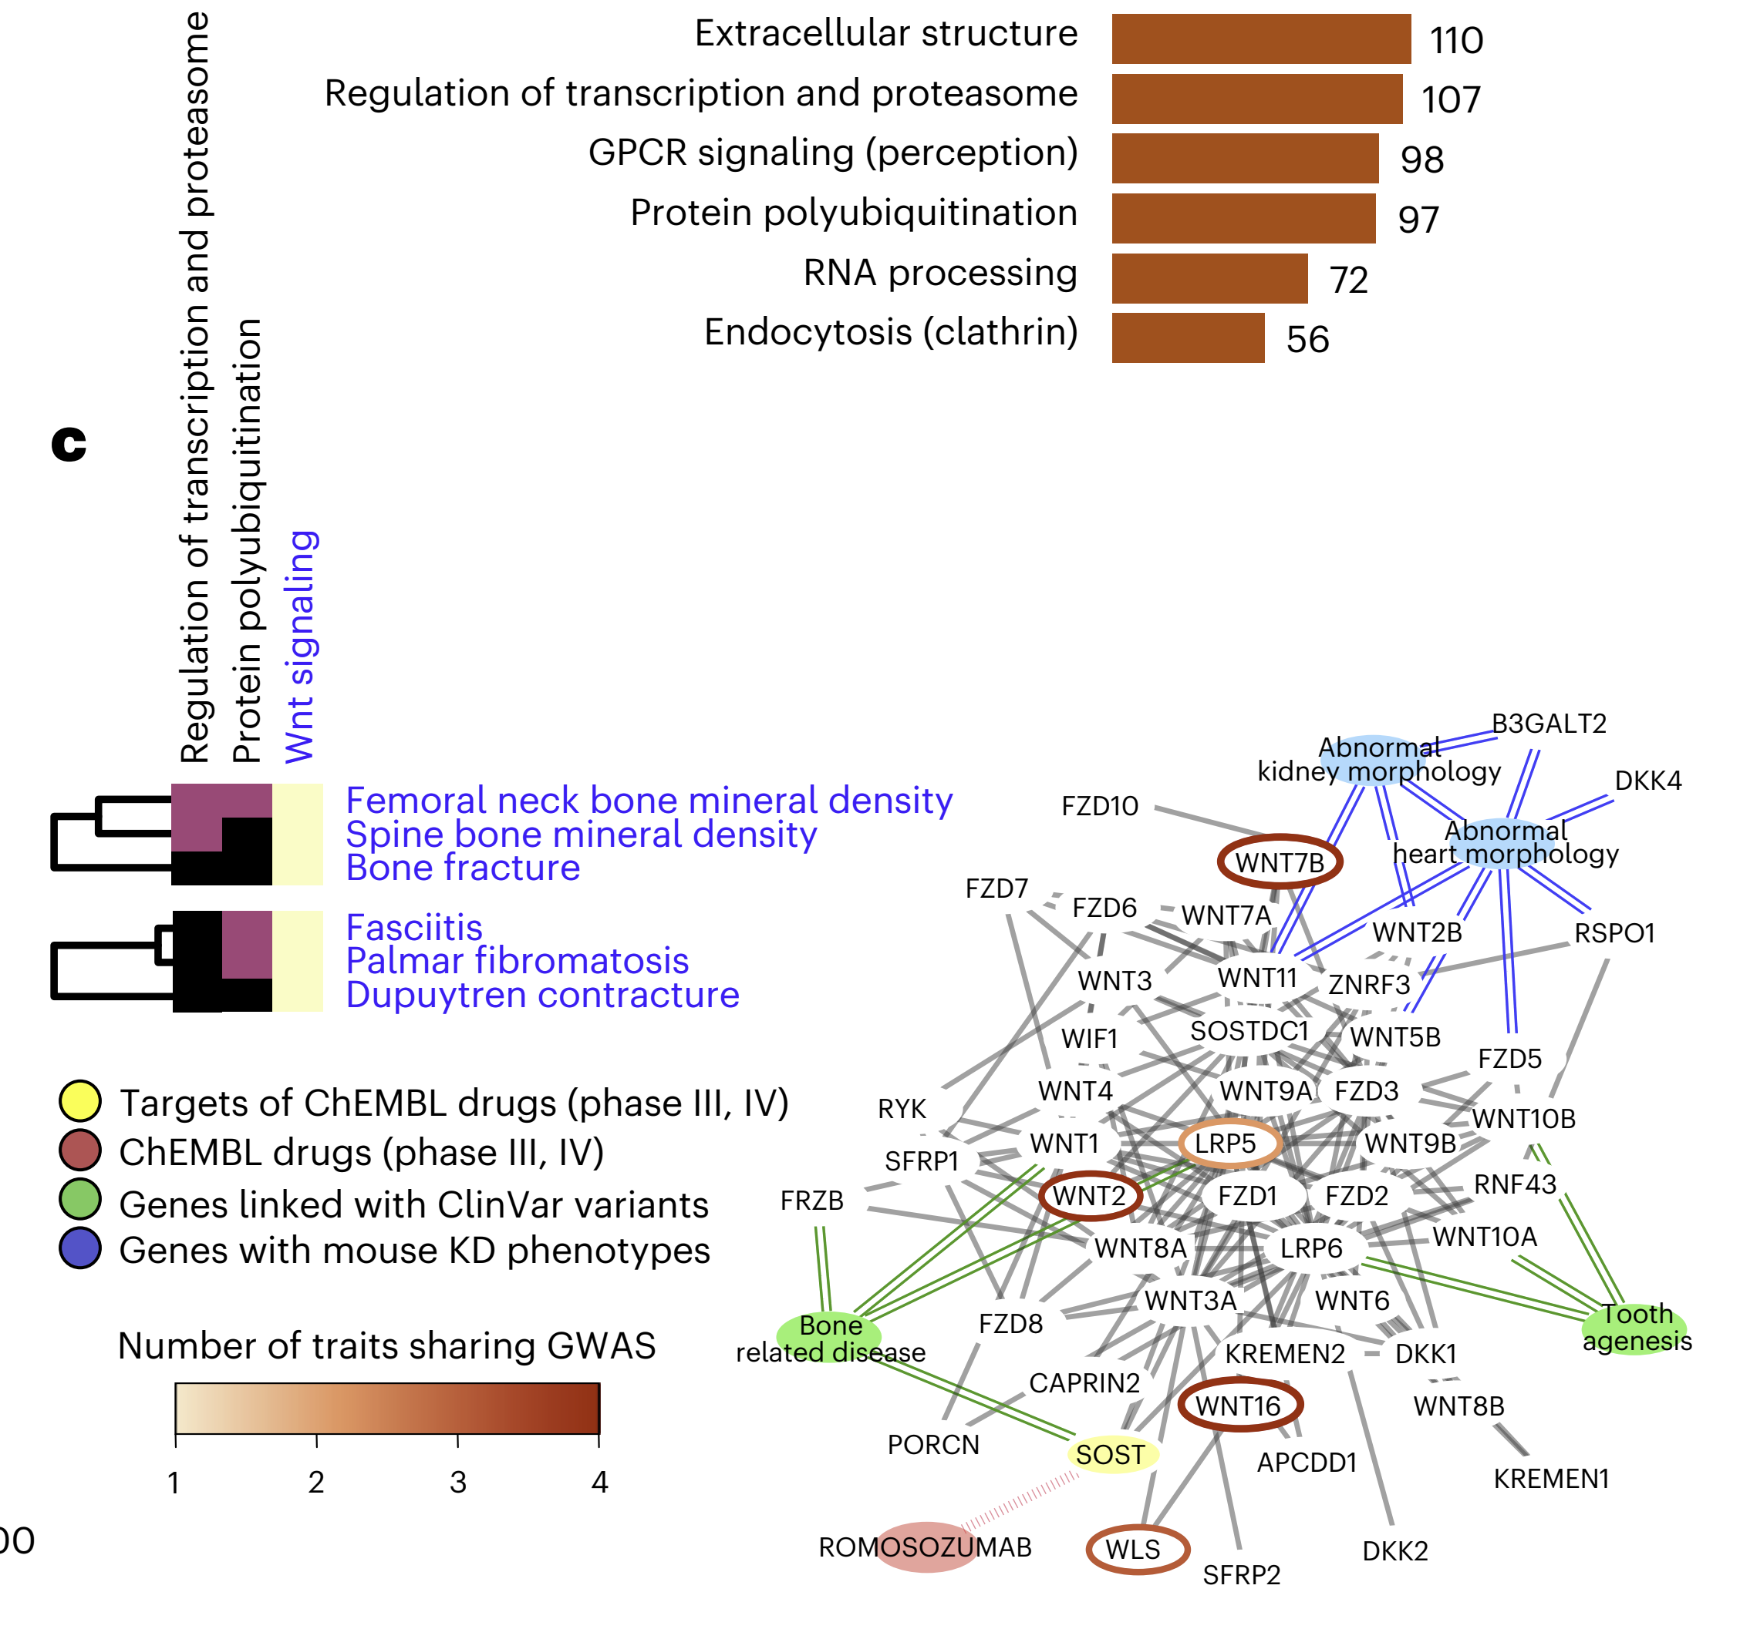
Network of Gene Modules in Immune Diseases
Notes:
Simple Explanation: This network map shows how different groups of genes (modules) involved in immune diseases are connected. It highlights which genes are targets of drugs or have known roles in diseases. The colored circles and lines help to identify which genes are involved in multiple diseases, showing how these diseases might be related at the genetic level.

Slide 22
Conclusions and Limitations
This study:
Developed a pleiotropy map using network-based expansion, providing a new way to analyze GWAS data and identify pleiotropic gene modules associated with multiple traits.
Showed the power of network propagation to recover known disease genes and drug targets, expanding the utility of GWAS beyond its traditional scope.
Identified 73 pleiotropic gene modules, highlighting shared cellular processes, such as protein ubiquitination and RNA processing, which are key to multicellular functions.
Notes:
Simple Explanation: The figure shows how many connections (edges) and elements (nodes) are in different parts of the interactome, which is a network of protein interactions. The largest component is from the STRING database, followed by the OTAR dataset. Smaller contributions come from IntAct, Reactome, and SIGNOR, showing how these sources combine to form a comprehensive network.

Slide 23
Conclusions and Limitations
This study:
focused on generalized networks, potentially limiting insight into tissue-specific or cell-type-specific interactions. Refining for context-specific networks could improve accuracy.
Relied on Personalized PageRank (PPR) for network propagation may overlook alternative network-based methods that could capture different aspects of gene relationships.
Notes:
Simple Explanation: The figure shows how many connections (edges) and elements (nodes) are in different parts of the interactome, which is a network of protein interactions. The largest component is from the STRING database, followed by the OTAR dataset. Smaller contributions come from IntAct, Reactome, and SIGNOR, showing how these sources combine to form a comprehensive network.

Slide 24
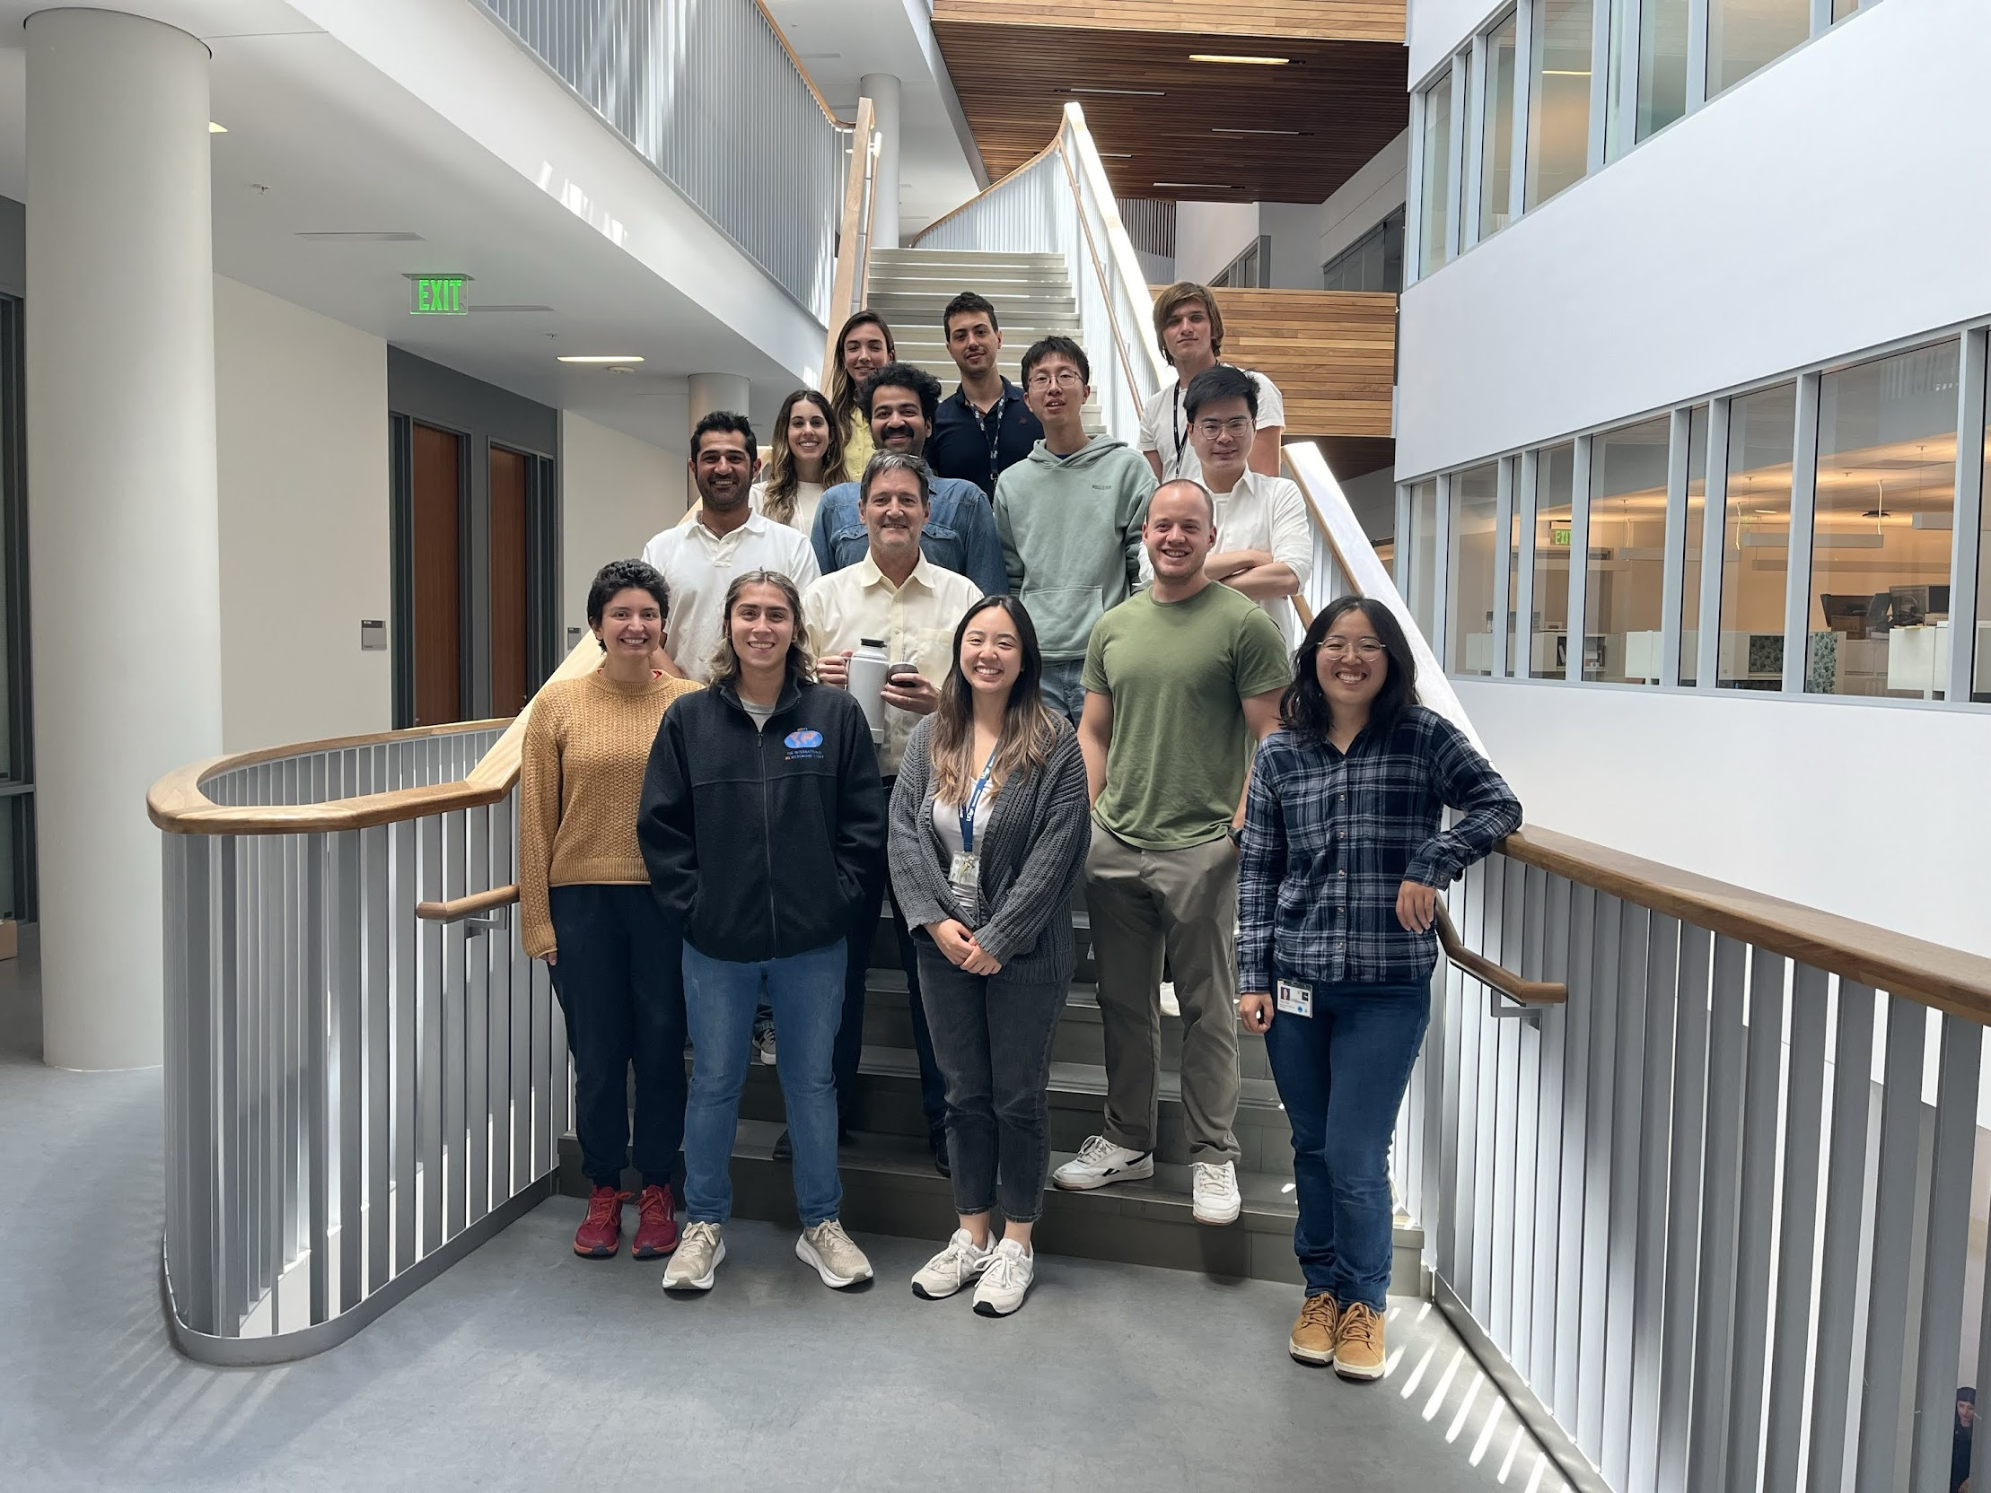
Acknowledgement and Reference
Dr. David Quigley
Dr. Sergio Baranzini
The Baranzini Lab
BMI 2023 Cohort
Barrio-Hernandez, I., Schwartzentruber, J., Shrivastava, A., Del-Toro, N., Gonzalez, A., Zhang, Q., et al. (2023). Network expansion of genetic associations defines a pleiotropy map of human cell biology. Nat. Genet. 55, 389–398.
Gao, B., and Zhou, X. (2024). MESuSiE enables scalable and powerful multi-ancestry fine-mapping of causal variants in genome-wide association studies. Nat. Genet. 56, 170–179. Sánchez-Jiménez, P., Elizalde-Horcada, M., Sanz-García, A., Granero-Cremades, I., De Toledo, M., Pulido, P., et al. (2023). DNA methylation description of hippocampus, cortex, amygdala, and blood of drug-resistant temporal lobe epilepsy. Mol. Neurobiol. 60, 2070–2085. Zhao, L., Qi, X., Chen, Y., Qiao, Y., Bu, D., Wu, Y., et al. (2023). Biological knowledge graph-guided investigation of immune therapy response in cancer with graph neural network. Brief. Bioinform. 24, bbad023.
Notes:
Simple Explanation: The figure shows how many connections (edges) and elements (nodes) are in different parts of the interactome, which is a network of protein interactions. The largest component is from the STRING database, followed by the OTAR dataset. Smaller contributions come from IntAct, Reactome, and SIGNOR, showing how these sources combine to form a comprehensive network.

